Slide 1

Digital Rights and Democracy:
Navigating AI, Surveillance, and Privacy
2025-26 Training As Action Series
Module 8
Notes:
SAAH

Slide 2
Check-In In The Chat:
Your Name
Your Role (i.e. Teacher, Student)
Institution and Location
One thing you’re looking forward to doing this Spring
Notes:
SAAH

Slide 3
Agenda
Welcome and Check-In
Group Expectations and Norms
Technology and Human Rights
Governing technology in accordance with human rights
Dialogue and Discussion about AI, Surveillance, and Privacy & Human Rights
Evaluation and Parting Words
Notes:
SAAH

Slide 4
What is Human Rights Education & Training?
A lifelong process of teaching and learning that helps individuals, groups, and communities:
  Develop the knowledge, skills, and values to fully exercise and protect their human rights and those of others;
  Fulfill their responsibilities in the context of internationally recognized human rights principles;
  Achieve justice and peace in the world.
Notes:
JAKE

Slide 5
HRE: About, Through & For
(a) Education about human rights, which includes providing knowledge and understanding of human rights norms and principles, the values that underpin them and the mechanisms for their protection;
(b) Education through human rights, which includes learning and teaching in a way that respects the rights of both educators and learners;
(c) Education for human rights, which includes empowering persons to enjoy and exercise their rights and to respect and uphold the rights of others” (UNDHRET, 2011).
Notes:
JAKE

Slide 6

Group Expectations
Notes:
SAAH

Slide 7
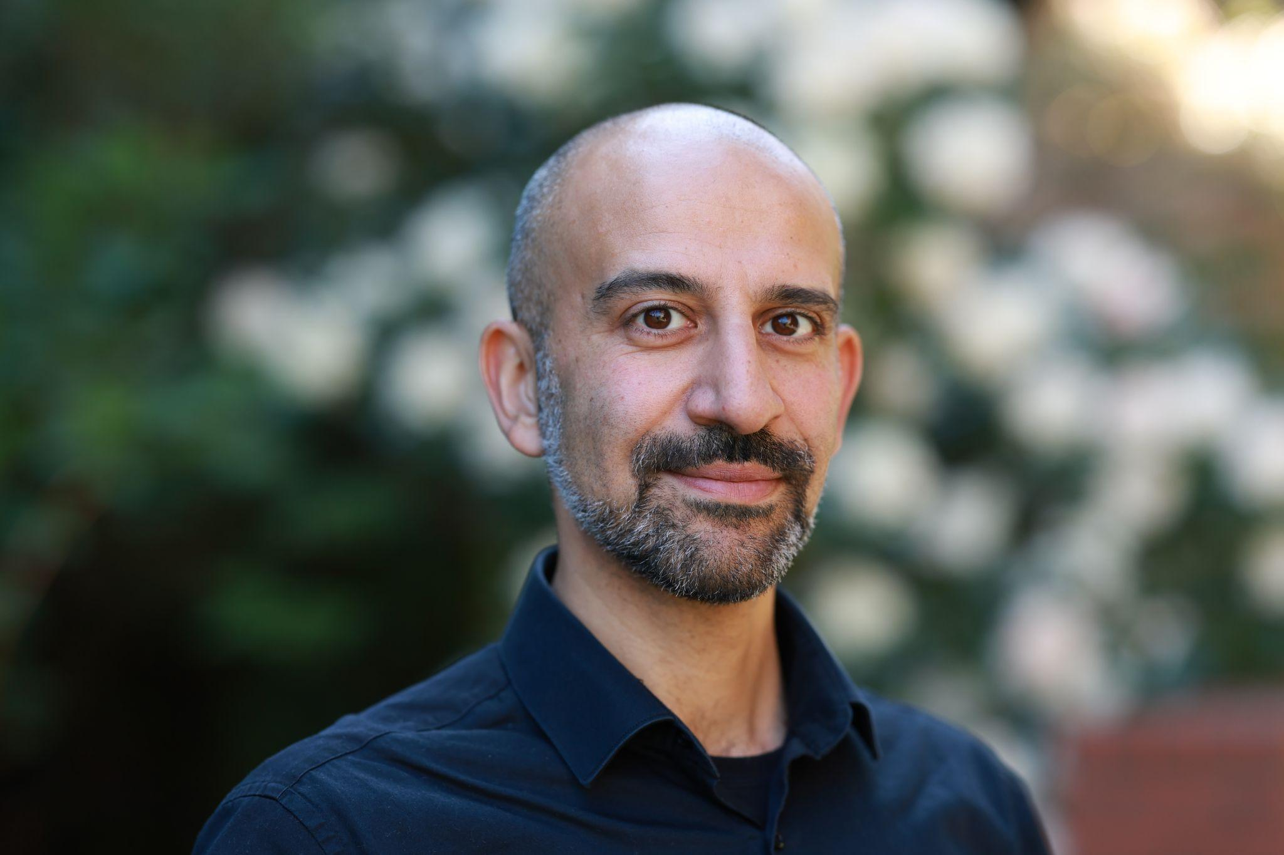
Facilitator Introduction:
Dr. Onur Bakiner is professor of political science and director of the Technology Ethics Initiative at Seattle University. His research and teaching interests include technology & society, technology governance, human rights, and judicial politics. His current research examines governance models to mitigate AI risks and harms. He has delivered public lectures in universities, nonprofits, international organizations and business associations in the United States, Colombia, Canada, Turkey and Germany on the societal implications of technology, judicial politics, and human rights.
His book Governing AI: A Primer has been published by the Cambridge University Press in 2026. His first book Truth Commissions: Memory, Power, and Legitimacy (University of Pennsylvania Press, 2015) has been awarded the Best Book Award by the Human Rights Section of the American Political Science Association in 2017.
Professor Onur Bakiner
Seattle University
Notes:
ALL

Slide 8
Technology and human rights
•Technology can enhance human rights protections
–E.g.: smartphone cameras during protests
•Technological change requires new human rights protections
–E.g.: privacy in the age of cameras
•Technology can be used for human rights violations
–E.g.: war technologies

Slide 9
Governing technology in accordance with human rights
Approaches
  allow technological development
  set rules on technological development
  ban technological development
Balancing approach
  Allow technological development when it poses little or no risk for human rights
  Set rules on technological development that produces serious risks and harms
  Ban technological development that poses unacceptable risks and harms for human rights

Slide 10
Question (In the chat)
What are the leading human rights promises and risks posed by various types of artificial intelligence (AI) today?
Notes:
NINA

Slide 11
Discussion and Dialogue
What would be the ideal way(s) to govern Artificial Intelligence today?
What are the responsibilities of (federal and local) governments, businesses, universities, and citizens?
Notes:
JAKE

Slide 12
Small Group Strategy Building
Guiding Questions:
Should AI be incorporated into higher education? If so, why? If not, why not?
What should be the appropriate policy responses by faculty members, departments/programs, and university administrators?
Where do you see gaps in current approaches to AI governance on campuses?
How can those gaps be addressed in the future?
Notes:
NINA

Slide 13
Session HRE Resource Links
Bakiner, Onur. “The promises and challenges of addressing artificial intelligence with human rights.” Big Data & Society, 10(2) (2023).
Benjamin, Ruha. Viral Justice: How We Grow the World We Want. Princeton University Press, 2022.
Crawford, Kate. The Atlas of AI: Power, Politics, and the Planetary Costs of Artificial Intelligence. Yale University Press, 2021.
Risse, Mathias. “Human rights and artificial intelligence: An urgently needed agenda.” Human Rights Quarterly 41.1 (2019): 1-16.
Notes:
NINA

Slide 14
Session Evaluation
TAAS Module 8 Feedback
Notes:
NINA

Slide 15
Opportunities & Events
Training As Action Series & Opportunities
Training As Action Series 2025-2026
Next Session: Monday, April 13th @ 7:00 pm ET
Module 9: Action Lab: Strategies for Defending Democracy and Human Rights
Become a Member
Join A Team – Complete our 2026 HRE USA Leadership Survey

Slide 16

Communications and Forum
Monthly E-Newsletter and Reports
Discussion Forum, Blog, and Social Media
** LinkedIn, Facebook, Instagram
Human Rights Education Now! Podcast
Human Rights Lesson Library & Collections
Briefs on HRE and Linkages
Artist: Judy Nao

Slide 17
Action Teams
Advocacy and Policy Team
Awards, Recognitions and Special Events Team
Fellowships, Internships and Professional Support Team
Innovations and Partnerships Team
Membership & Sustainability Team
Podcast Team
Professional Development and Training Team
Regional Representative Team
Strategy and Priorities Team
Sign Up through our:
2026 HRE USA Leadership Survey

Slide 18

The 2025-26 TAAS Series is made possible with support from our 21 co-sponsors and Session Facilitator Dr. Onur Bakinur!
We are grateful for the generous support of our members, individual donors, and The Puffin Foundation Ltd.
HRE USA is a project of the Center for Transformative Action.

