Slide 1

Intersectional Democracy: Gender and Disability
2025-26 Training As Action Series
Module 7
Notes:
SAAH

Slide 2
Check-In In The Chat:
Your Name
Your Role (i.e. Teacher, Student)
Institution and Location
One thing you’re looking forward to doing this Spring (does not have to be human rights related)
Notes:
SAAH

Slide 3
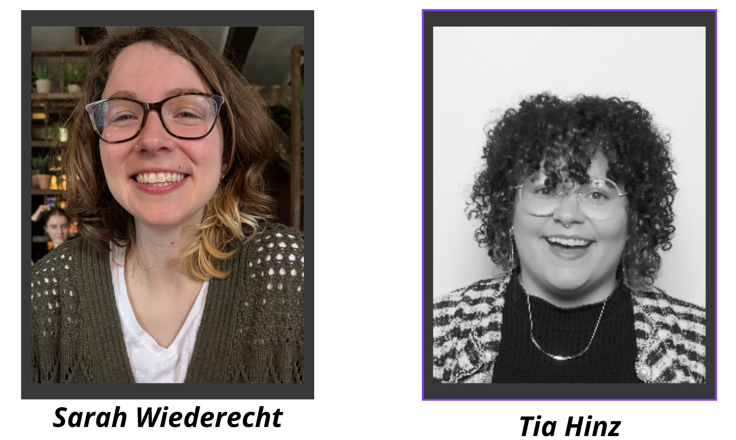
Facilitator Introductions:
She/They
She/They
Notes:
ALL

Slide 4
What is Human Rights Education and Learning?
A lifelong process of teaching and learning that helps individuals, groups, and communities:
  Develop the knowledge, skills, and values to fully exercise and protect their human rights and those of others;
  Fulfill our responsibilities in the context of internationally recognized human rights principles;
  Achieve justice and peace in the world
  In education settings and beyond!
Notes:
JAKE

Slide 5

Group Expectations
Respect
Boundaries
Self Care
Growth Mindset
Notes:
SAAH

Slide 6
Opening Question (In the chat)
In what ways do you see
gender and disability
overlap or intersect?
Notes:
NINA

Slide 7
Discussion
What is it like being a person with a disability in an educator role?
How does gender impact the lived experiences of educators?
Teaching about gender in the classroom…
Teaching about disability in the classroom…
Notes:
JAKE

Slide 8

In the Classroom: Disability
Context: the Avatar is looking for a teacher…
Observations
Assumptions
Realities

Slide 9



In the Classroom: Gender
Notes:
JAKE

Slide 10
HRE: About, Through & For
(a) Education about human rights, which includes providing knowledge and understanding of human rights norms and principles, the values that underpin them and the mechanisms for their protection;
(b) Education through human rights, which includes learning and teaching in a way that respects the rights of both educators and learners;
(c) Education for human rights, which includes empowering persons to enjoy and exercise their rights and to respect and uphold the rights of others” (UNDHRET, 2011).
Notes:
JAKE

Slide 11

Breakouts: ADA Check in Your Space
Link
Location | ✔️ or ❌ | Observations
Are doors 32” in width or more?
Is there an accessible way to get into the school to the Main Office?
Is there an accessible way to get into the school to the Freshman Center?
Are there accessible parking spaces in the parking lot you looked out onto?
Are the elevators in service? Do not use them, just check for a sign.
Are countertops in the school all the same height? Or are there lower and higher levels?
Does the cafeteria offer an accessible way to get around?
Are there accessibility features for the announcements?
Do any classrooms have an accessible desk? (ex: one fit for a wheelchair user).
Is Braille used in any parts of the building?
Is the lower water fountain 36” or less from the ground?
Do any sinks allow for leg space below the bowl? Are they 34” tall?
Does the accessible restroom (Large Stall) have a bar?
Notes:
NINA

Slide 12

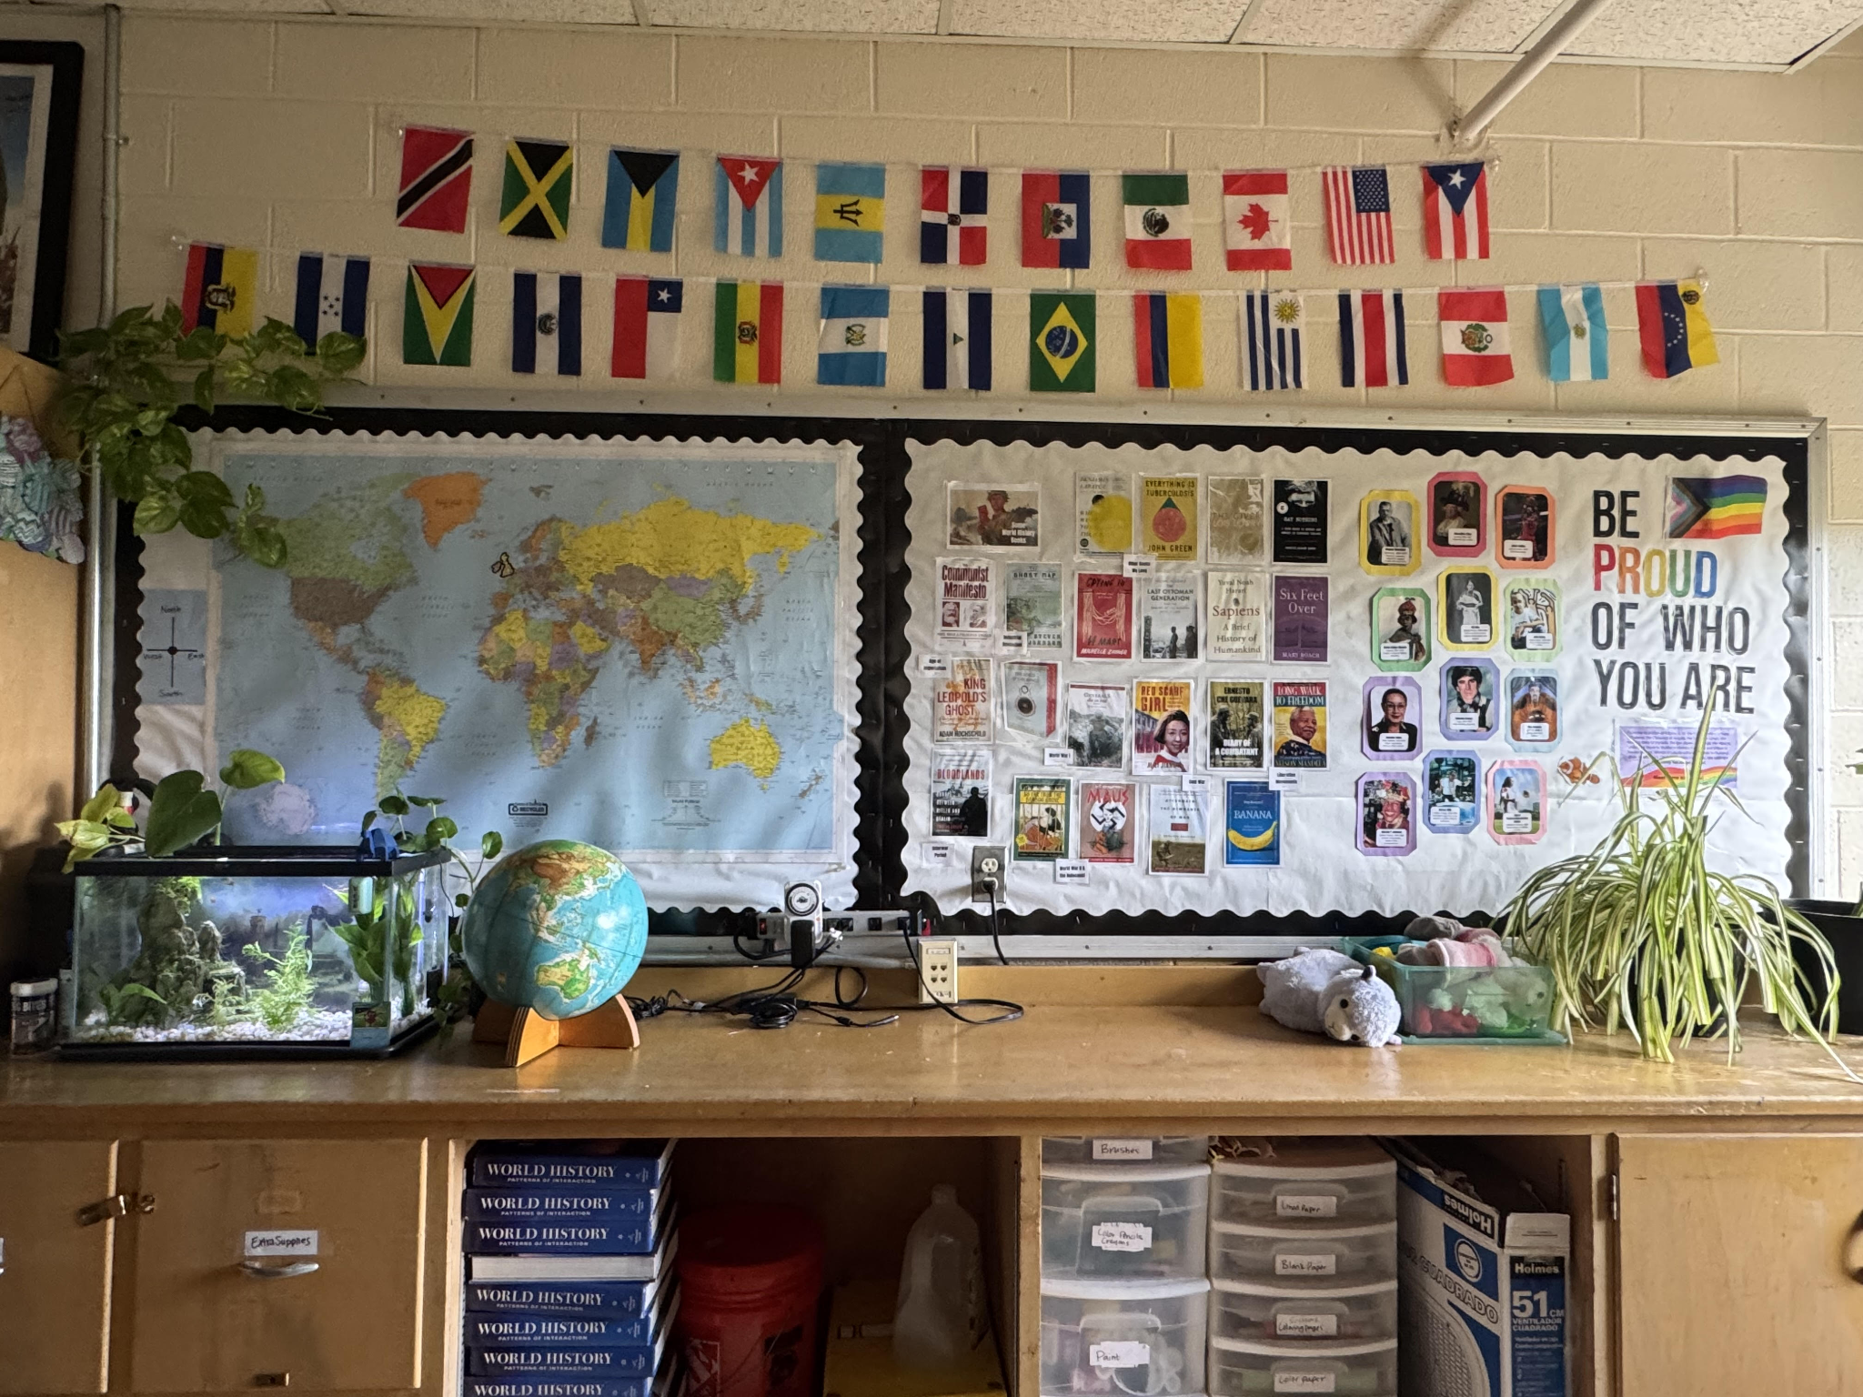
Gender Informed Classrooms
Notes:
NINA

Slide 13
Session HRE Resource Links
Disability Rights - Google Drive - Sarah Wiederecht’s HRE Folder on Disability Rights Advocacy and Intersectionality
Human Rights. YES! Contents – Action and Advocacy on the Rights of Persons with Disabilities, 2nd Ed.
Human Rights Education Series: Topic Book 6
Notes:
NINA

Slide 14
Session Evaluation
TAAS Module Feedback
Notes:
NINA

Slide 15

Special thanks to TAAS 7 Co-facilitators,
Tia Hinz and Sarah Wiederecht!
Much gratitude to our 21 Organization Co-Sponsors for the 2025-26 TAAS Series!
We are grateful for the generous support of our members, individual donors, and The Puffin Foundation Ltd.
HRE USA is a project of the Center for Transformative Action.

Slide 16
Opportunities & Events
Training As Action Series 2025-2026
Next Session: Monday, March 9th @ 7:00 pm ET
Module 8: Digital Rights and Democracy: Navigating AI, Surveillance, and Privacy
Become an HRE USA Member
Join An HRE USA Action Team

Slide 17
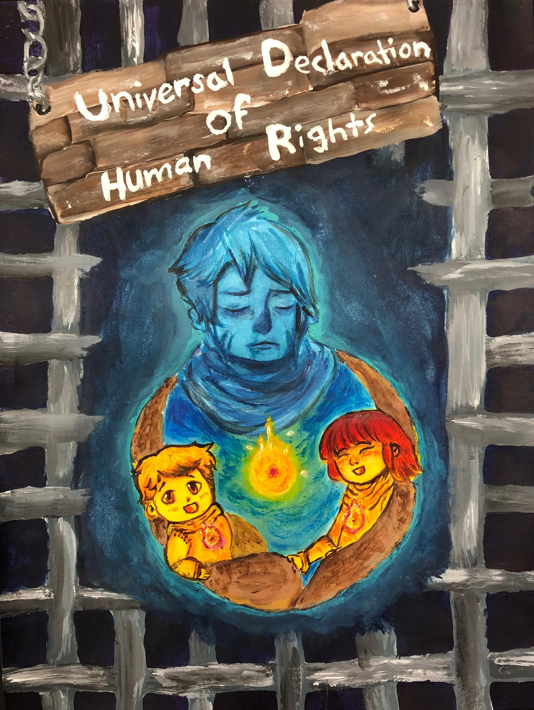
Communications and Forum
E-Newsletter
Discussion Forum
Blog and Social Media Posts
** LinkedIn, Facebook, Instagram
Podcast
Membership Profiles
Human Rights Here & Now Toolkits
HRE and Linkages Briefs
Annual Reports
Artist: Judy Nao

Slide 18
Action Teams
Advocacy and Policy Team
Awards, Recognitions and Special Events Team
Fellowships, Internships and Professional Support Team
Innovations and Partnerships Team
Membership & Sustainability Team
Podcast Team
Professional Development and Training Team
Regional Representative Team
Strategy and Priorities Team
Sign Up through our:
2026 HRE USA Leadership Survey

