Slide 1
Check-In In The Chat:
Your Name
Your Role (i.e. Teacher, Student)
Institution and Location
One thing you’re hopeful for or looking forward to (does not have to be human rights related)

Slide 2

Human Rights Education As A Response to Polarization

Slide 3
Agenda
Welcome and Check-In
Group Expectations and Norms
Polarization in Higher Education and K-12 Education
Breakout # 1: Problems & Possibilities
Full Group Debrief
Breakout # 2: Strategy Building
Full Group Debrief
Evaluation and Parting Words

Slide 4
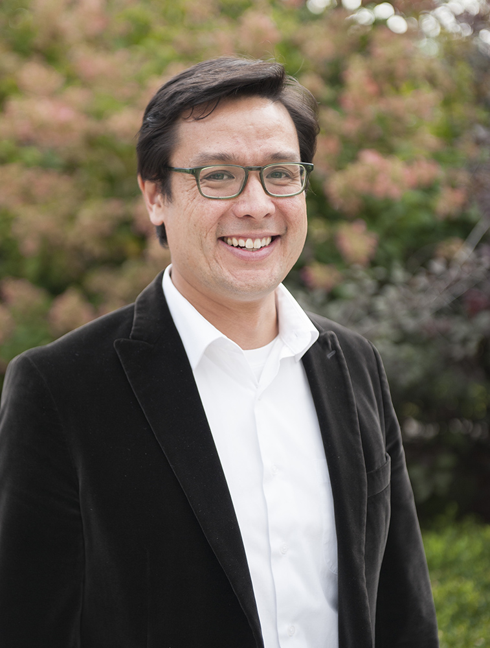
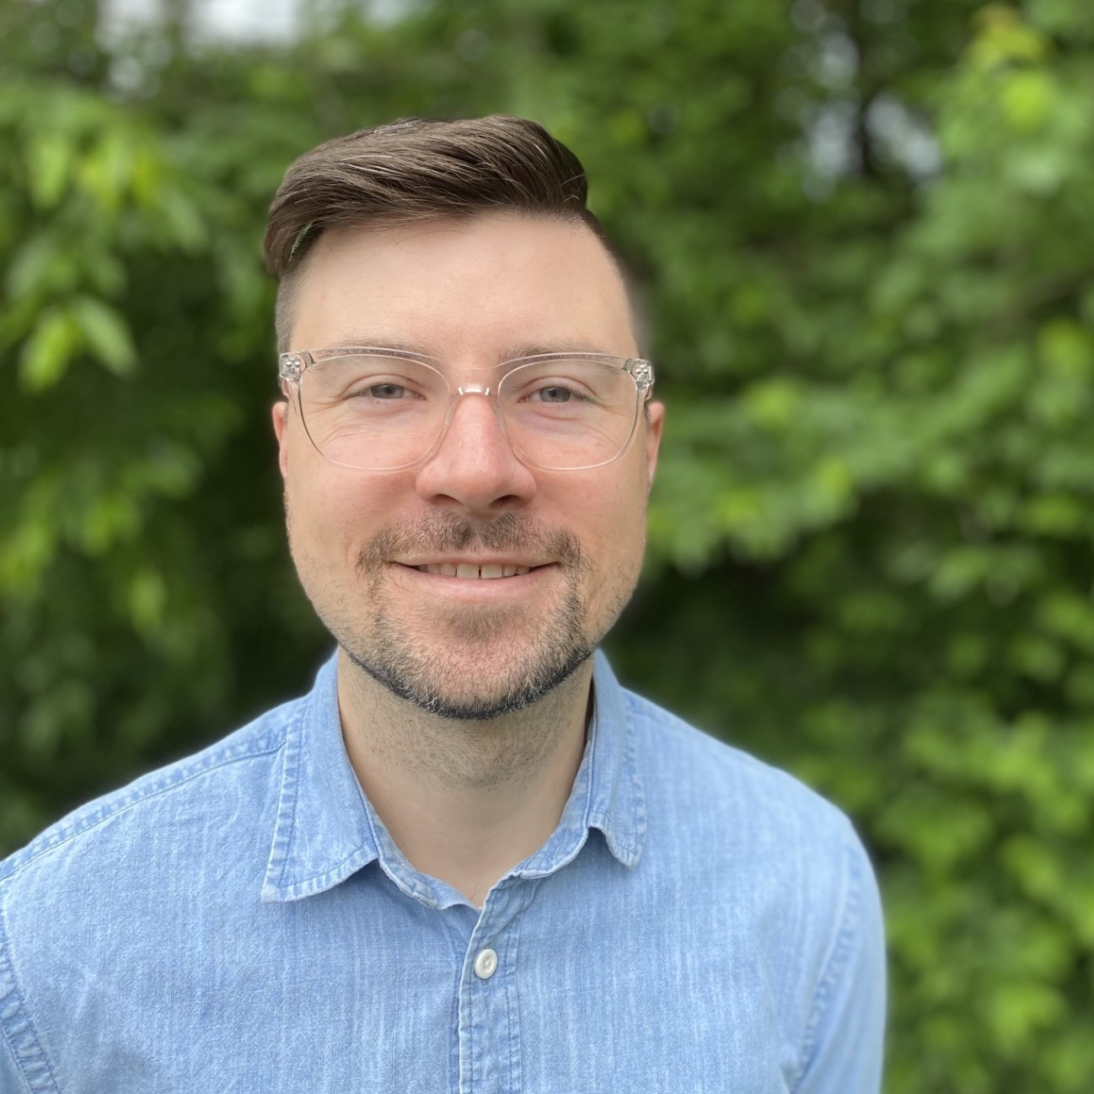
Facilitator Introductions:
Dr. Glenn Mitoma
Lecturer in the Discipline of Human Rights and Director of Undergraduate Studies
Institute for the Study of Human Rights
Columbia University
Jake Skrzypiec
Social Studies Teacher, CT
Steering Committee, HRE USA
Co-Chair, NCSS HRE Community
Notes:
ALL

Slide 5
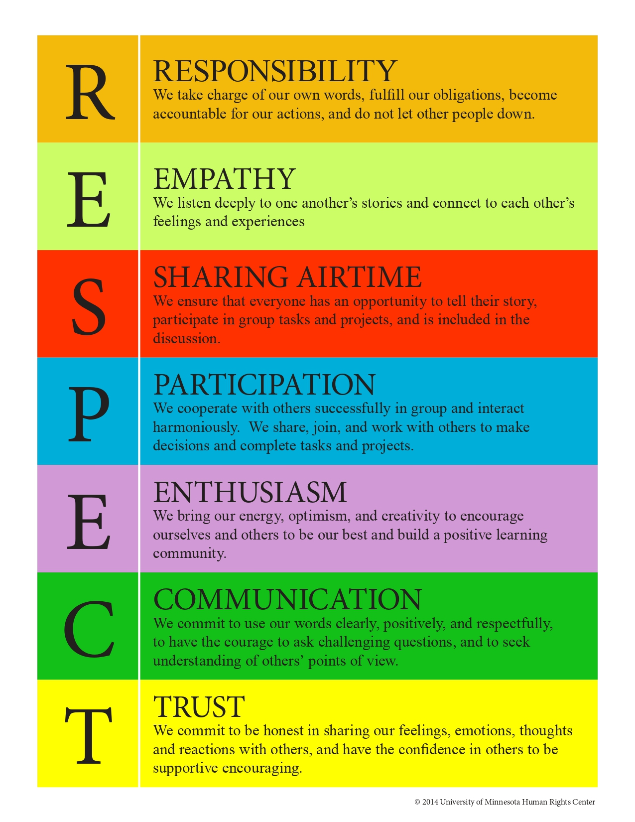
Group Expectations

Slide 6
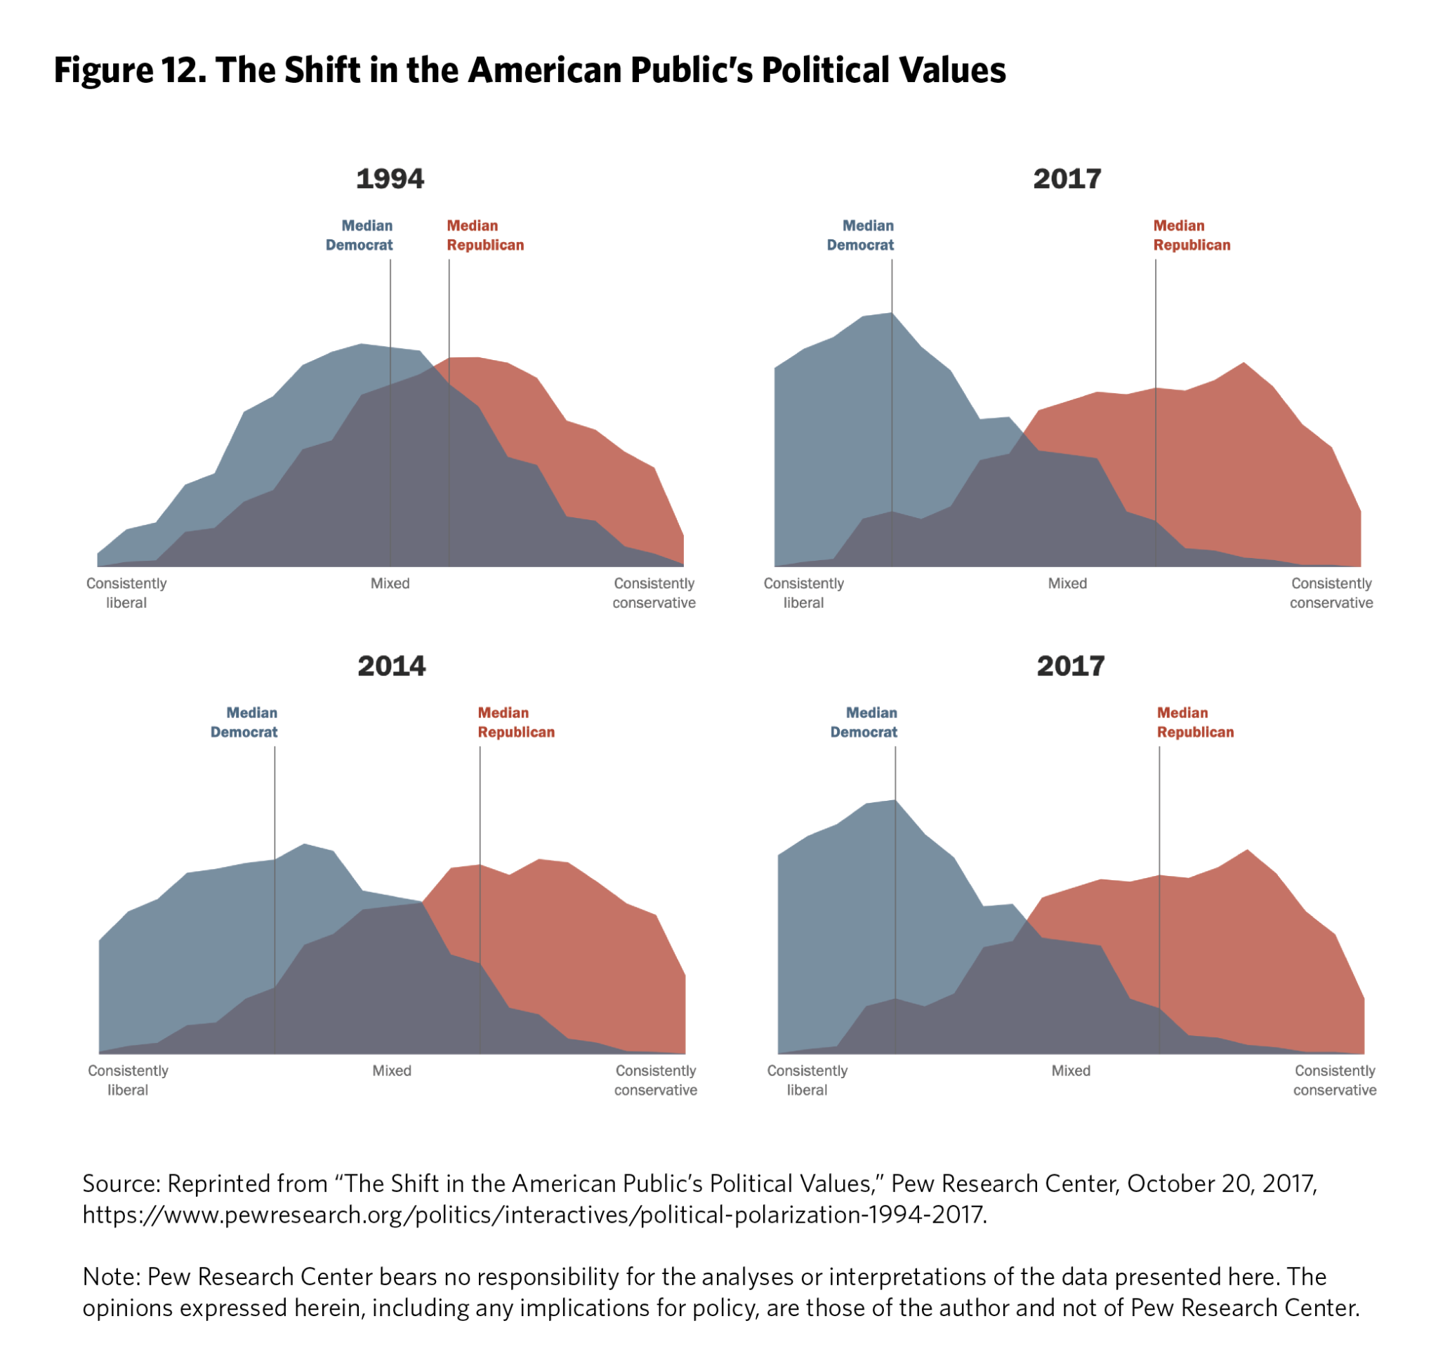
WHAT DO WE MEAN BY POLARIZATION
POLITICAL POLARIZATION
Notes:
GLENN

Slide 7
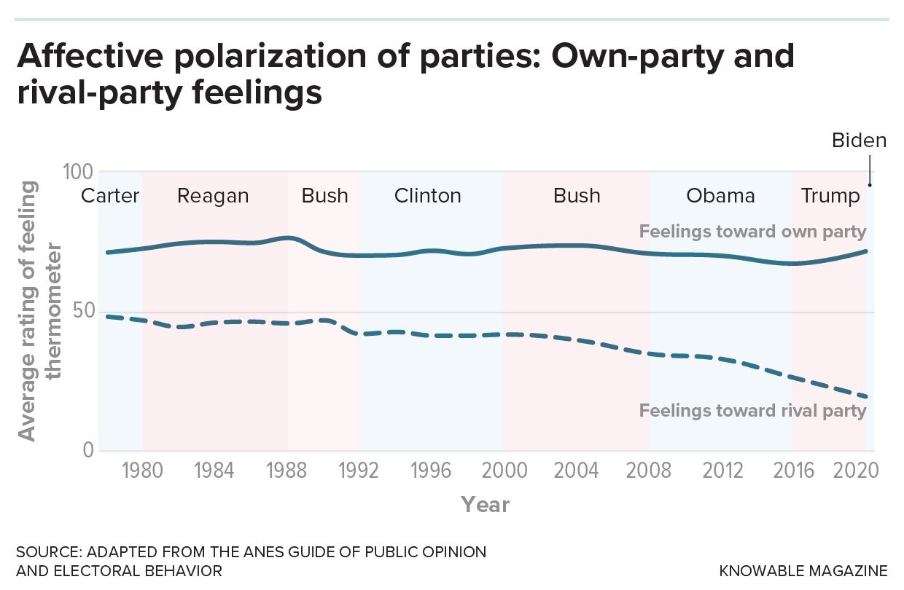
WHAT DO WE MEAN BY POLARIZATION
POLITICAL POLARIZATION
AFFECTIVE POLARIZATION
Notes:
GLENN

Slide 8
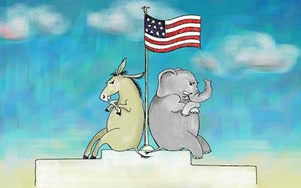
CONCERNS ABOUT POLARIZATION
DIVISION
Notes:
GLENN

Slide 9

CONCERNS ABOUT POLARIZATION
DISFUNCTION
DIVISION
Notes:
GLENN

Slide 10
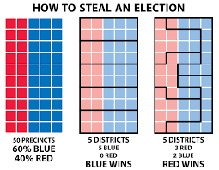
CONCERNS ABOUT POLARIZATION
DISFUNCTION
DIVISION
DEMOCRATIC
EROSION
Notes:
GLENN

Slide 11
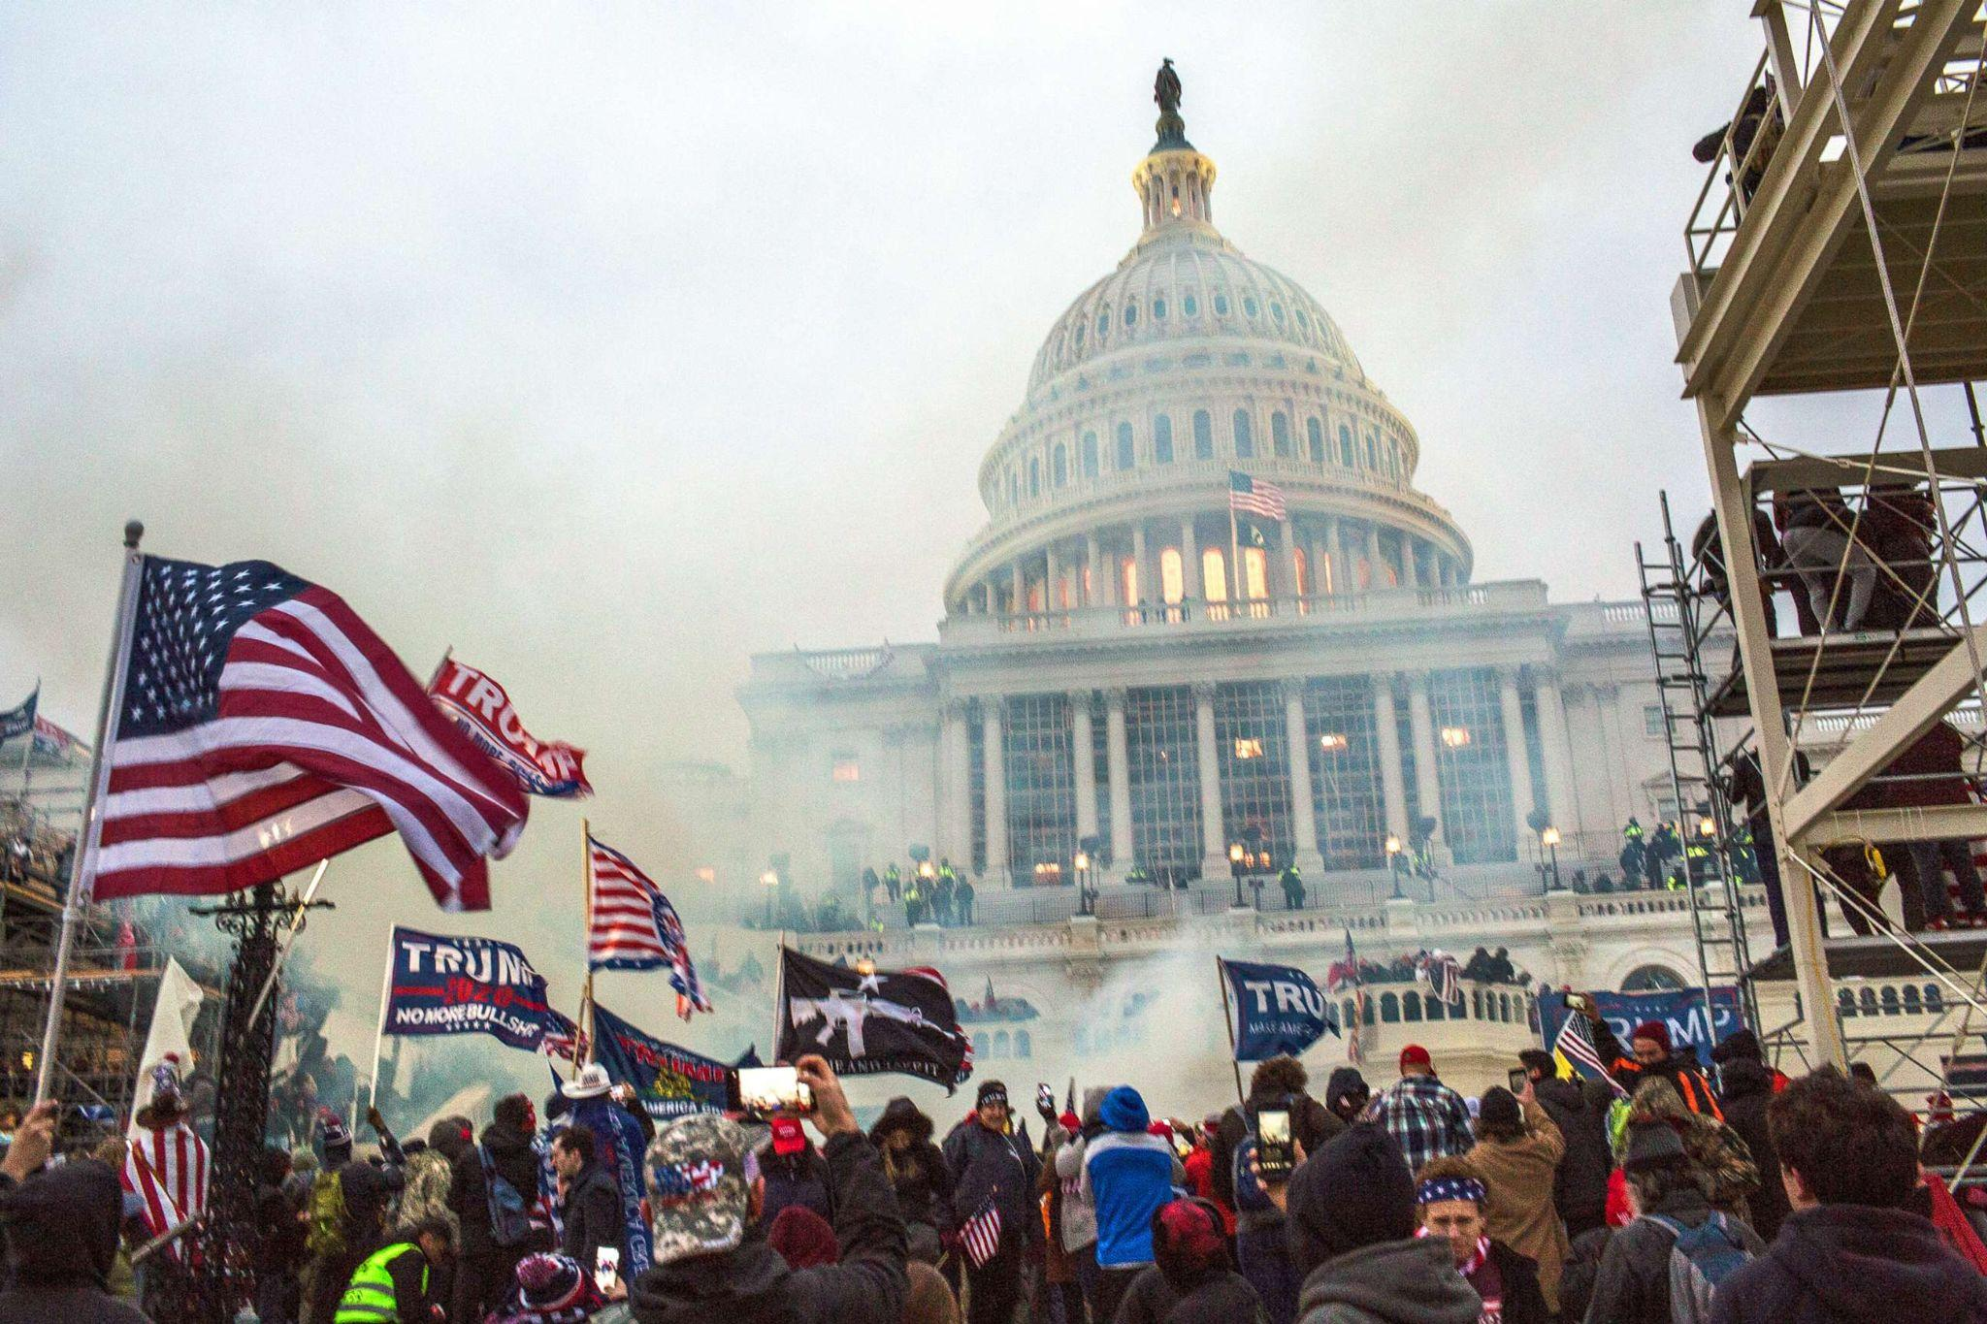
CONCERNS ABOUT POLARIZATION
DISFUNCTION
DIVISION
VIOLENCE
DEMOCRATIC
EROSION
Notes:
GLENN

Slide 12
POLARIZATION AND HIGHER EDUCATION
Notes:
GLENN

Slide 13
POLARIZATION AND HIGHER EDUCATION
POLARIZATION ABOUT HIGHER EDUCATION
Notes:
GLENN

Slide 14
POLARIZATION AND HIGHER EDUCATION
POLARIZATION ABOUT HIGHER EDUCATION
POLARIZATION THROUGH HIGHER EDUCATION
Notes:
GLENN

Slide 15
POLARIZATION AND HIGHER EDUCATION
POLARIZATION ABOUT HIGHER EDUCATION
POLARIZATION THROUGH HIGHER EDUCATION
POLARIZATION FOR IN HIGHER EDUCATION
Notes:
GLENN

Slide 16
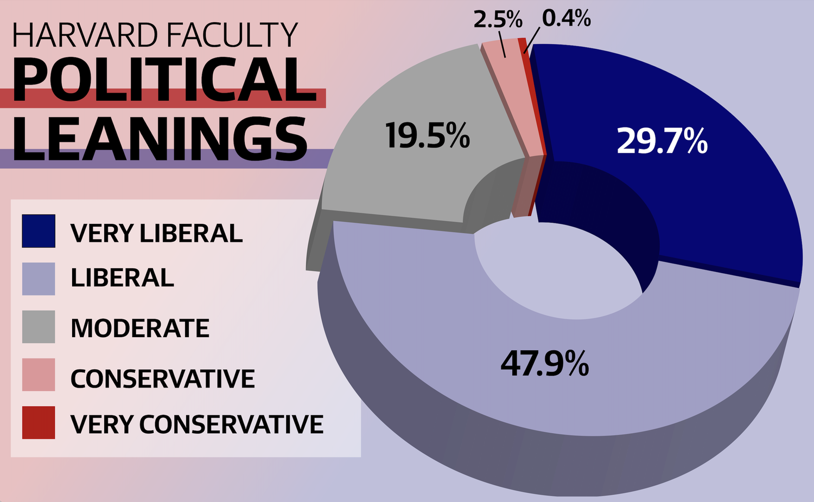
POLARIZATION AND HIGHER EDUCATION
NOT MUCH
POLARIZATION FOR IN HIGHER EDUCATION
Notes:
GLENN

Slide 17
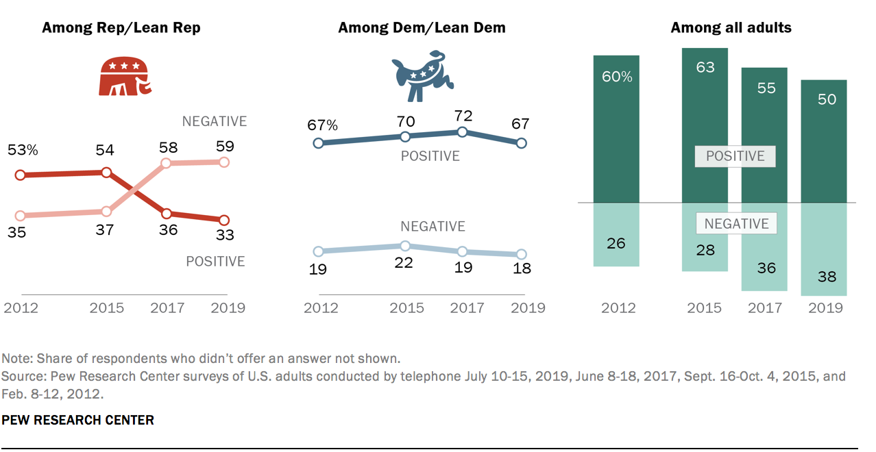
POLARIZATION AND HIGHER EDUCATION
POLARIZATION ABOUT HIGHER EDUCATION
Notes:
GLENN

Slide 18
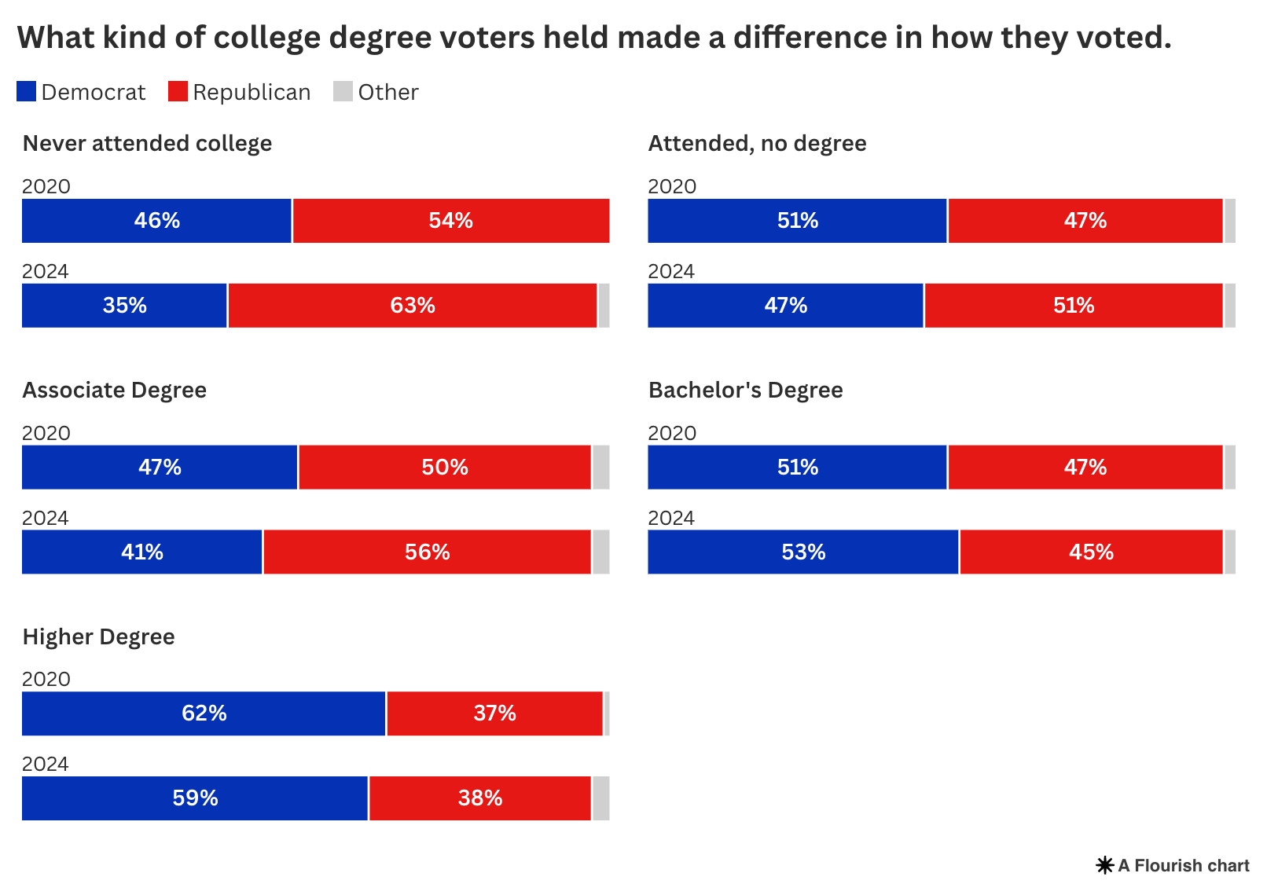
POLARIZATION AND HIGHER EDUCATION
POLARIZATION THROUGH HIGHER EDUCATION
Notes:
GLENN

Slide 19

POLARIZATION IN K-12 EDUCATION
Notes:
JAKE

Slide 20
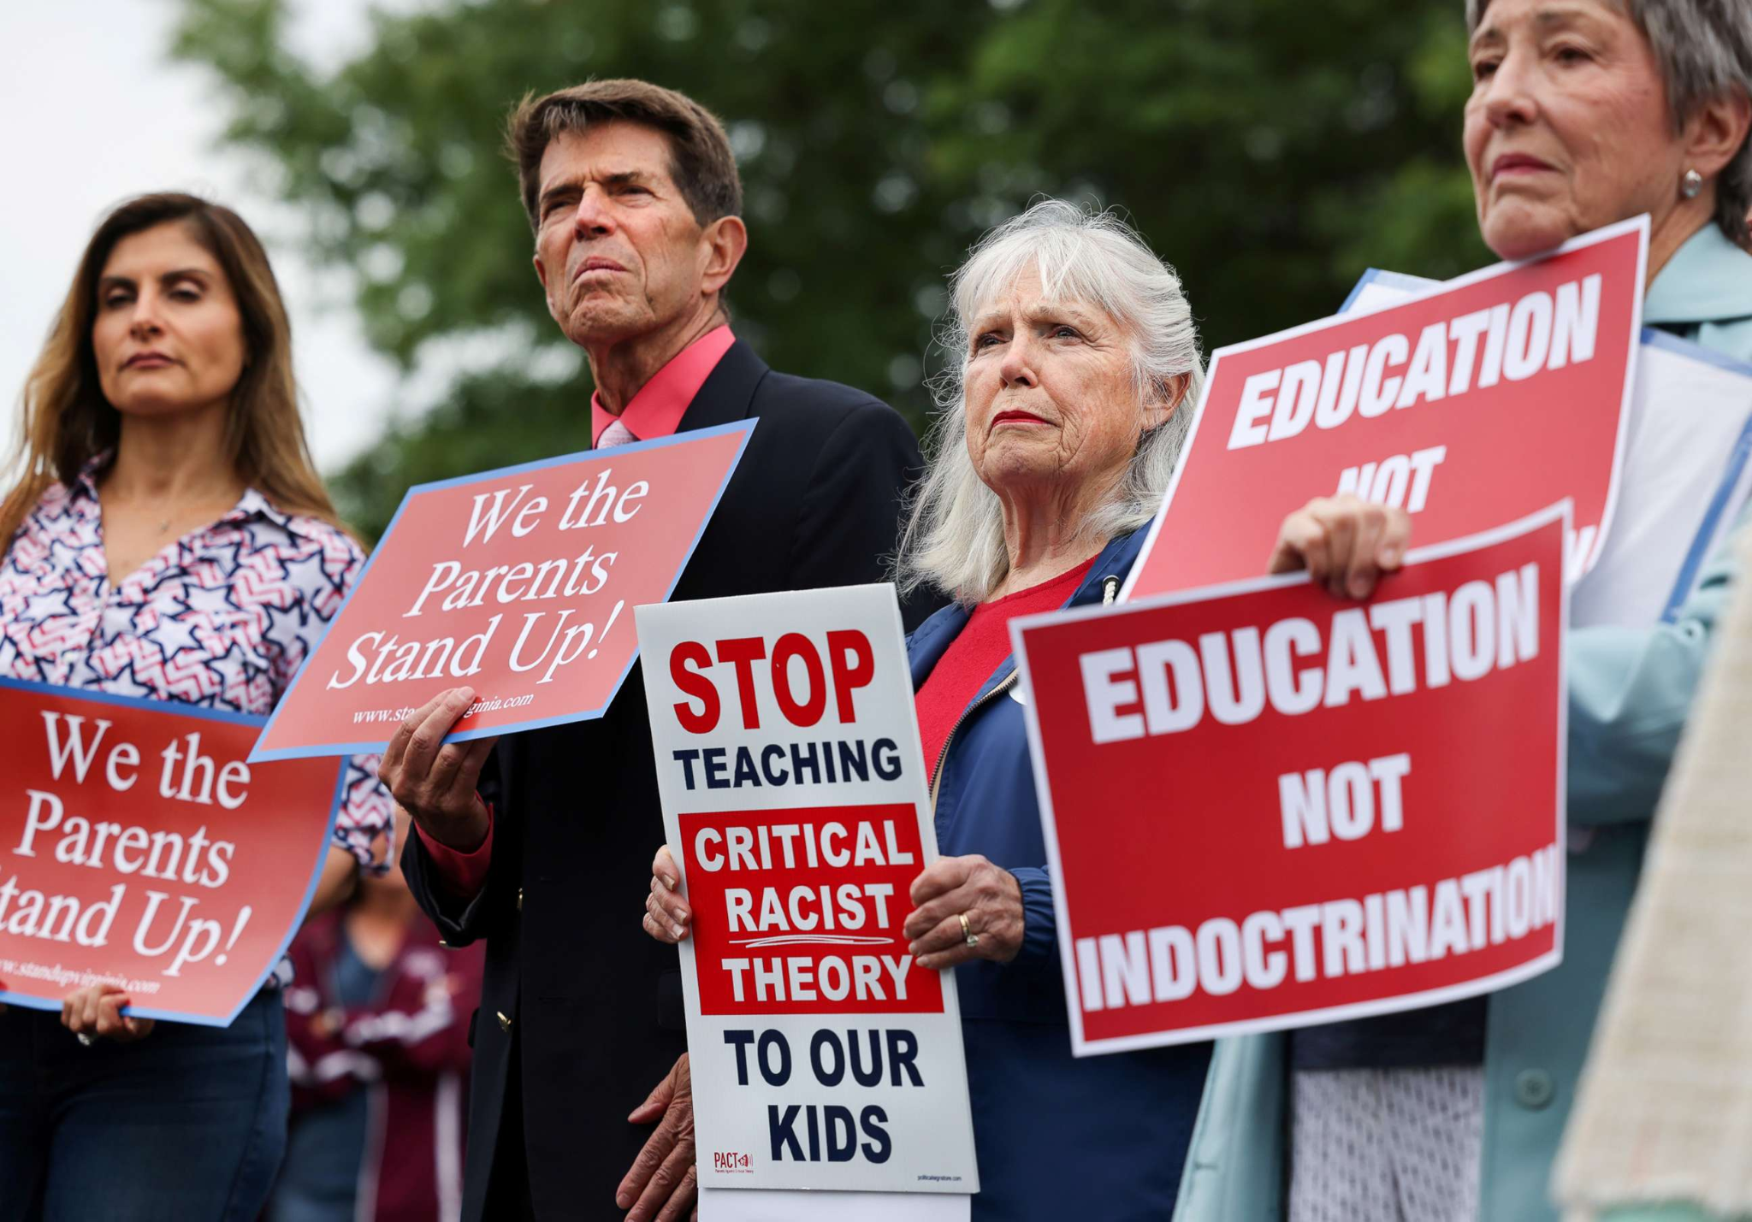
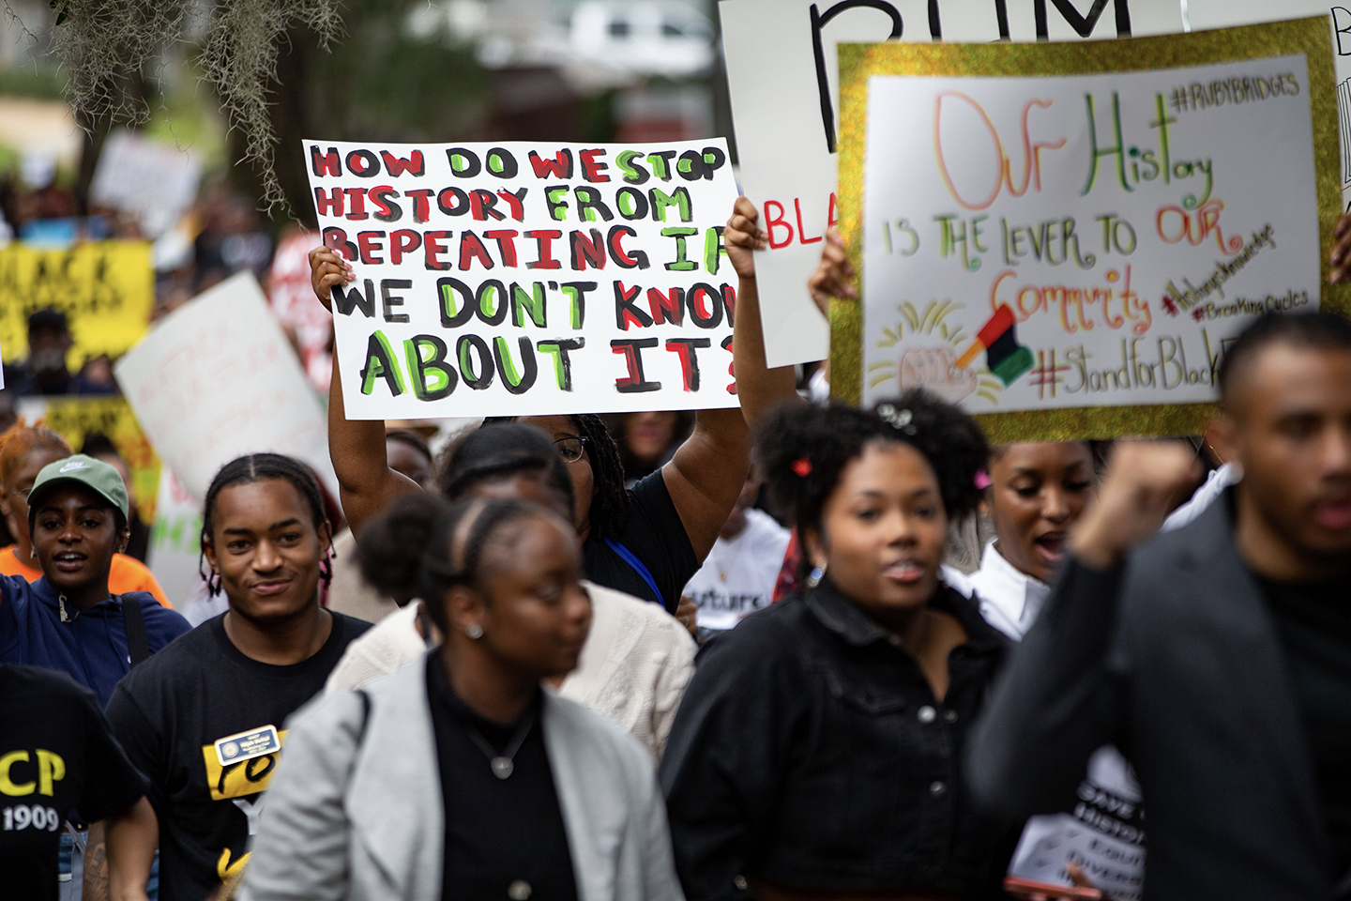
POLARIZATION IN K-12 EDUCATION
Notes:
JAKE

Slide 21
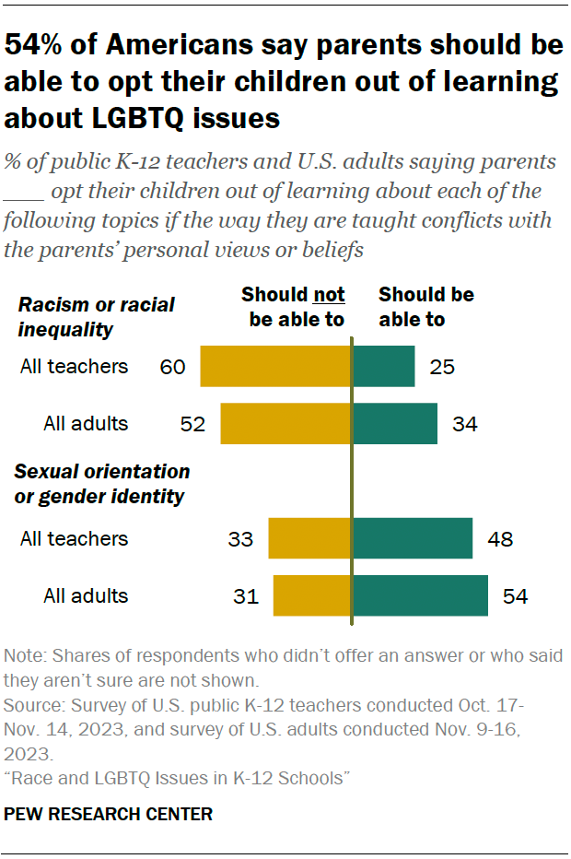
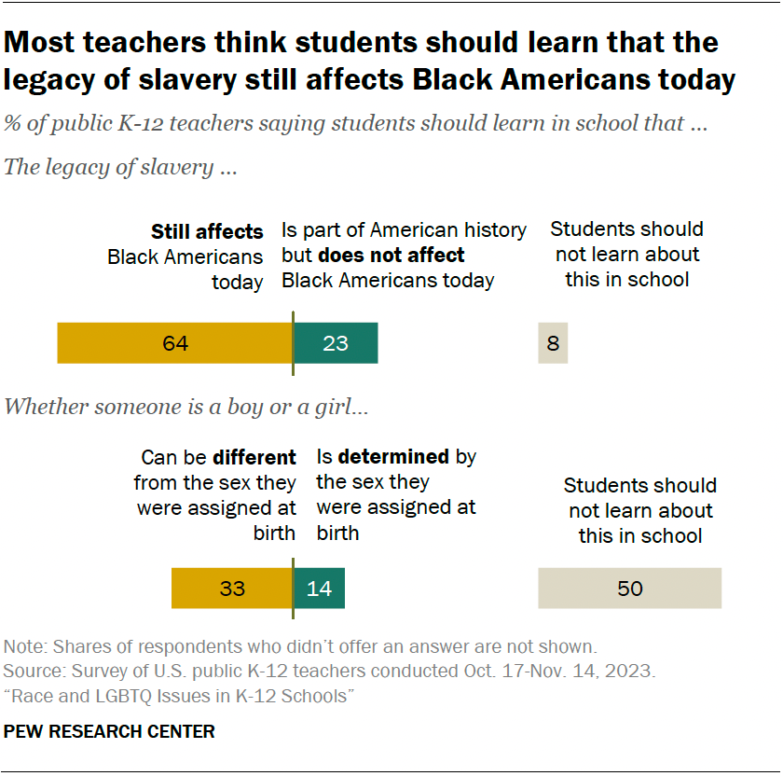
POLARIZATION IN K-12 EDUCATION
49% of parents said they’d rather their children learn that the legacy of slavery still affects the position of Black people in American society today, while 42% said they’d rather their children learn that slavery no longer affects Black Americans.
Notes:
JAKE

Slide 22
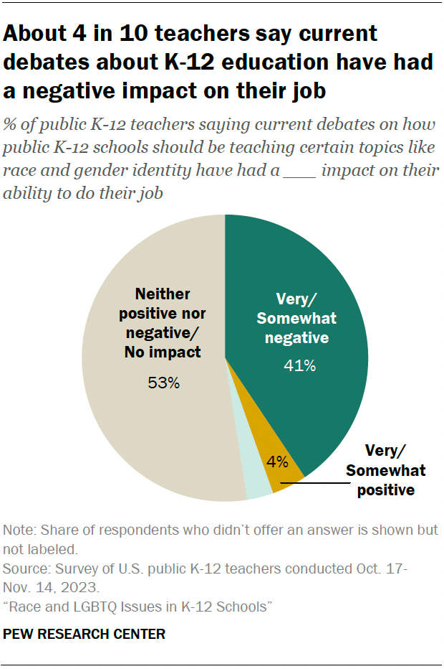
POLARIZATION IN K-12 EDUCATION
Notes:
JAKE

Slide 23


POLARIZATION IN K-12 EDUCATION
Operate as a tax-credit program where individuals can receive up to $1,700 in credits for donating to nonprofit scholarship-granting organizations. These groups can then distribute scholarships for private school tuition, tutoring, transportation, or even special education services. Families earning up to 300% of their area’s median income are eligible, and states must opt in, giving governors control over implementation.
Notes:
JAKE

Slide 24



POLARIZATION IN K-12 EDUCATION
Notes:
JAKE

Slide 25
Breakout # 1: Problems & Possibilities
QUESTION 1
HOW HAS POLARIZATION BEEN SHOWING UP IN YOUR WORLD? WHAT PROBLEMS HAS IT CREATED?
QUESTION 2
BASED ON WHAT YOU HEARD FOR Q.1, WHAT POSSIBILITIES DO YOU THINK POLARIZATION MIGHT OPEN UP FOR HRE?

Slide 26
Full Group Debrief

Slide 27
What are Human Rights?
Human rights are the rights that every human has just for being human, and they are essential for a life of dignity.
They are:
  Equal & Universal
  Inalienable
  Interdependent
Notes:
JAKE

Slide 28
What is Human Rights Education?
A lifelong process of teaching and learning that helps individuals, groups, and communities:
  Develop the knowledge, skills, and values to fully exercise and protect their human rights and those of others;
  Fulfill their responsibilities in the context of internationally recognized human rights principles;
  Achieve justice and peace in the world.
Notes:
JAKE

Slide 29
HRE: About, Through & For
(a) Education about human rights, which includes providing knowledge and understanding of human rights norms and principles, the values that underpin them and the mechanisms for their protection;
(b) Education through human rights, which includes learning and teaching in a way that respects the rights of both educators and learners;
(c) Education for human rights, which includes empowering persons to enjoy and exercise their rights and to respect and uphold the rights of others” (UNDHRET, 2011).
Notes:
JAKE

Slide 30
Why is HRE important? Why should it be pursued?
Promotes values, beliefs and attitudes that encourage all individuals to uphold their own rights and those of others.
Develops an understanding of everyone's common responsibility to make human rights a reality in each community.
Constitutes an essential contribution to the long-term prevention of human rights abuses.
Represents an important investment in the endeavour to achieve a just society in which all human rights of all persons are valued and respected. (OHCHR)
Notes:
JAKE

Slide 31
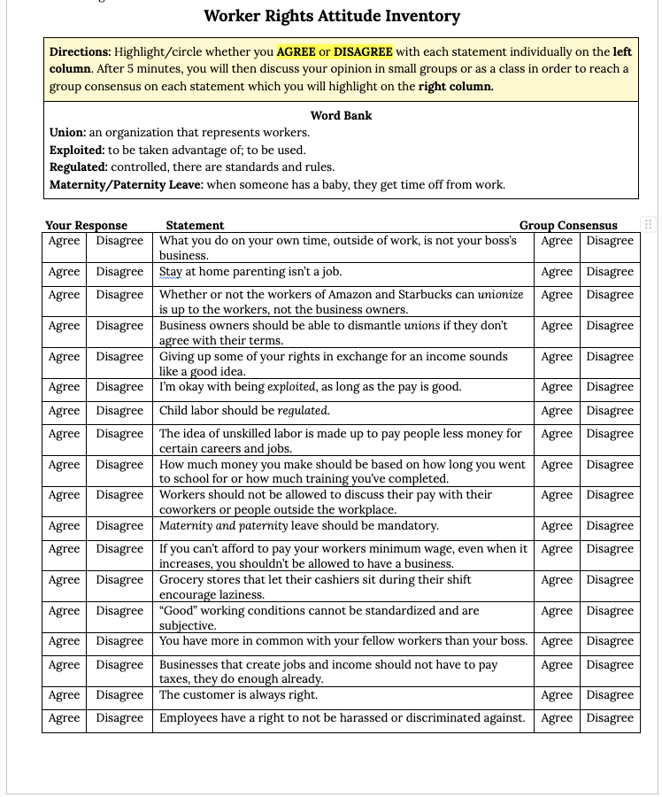
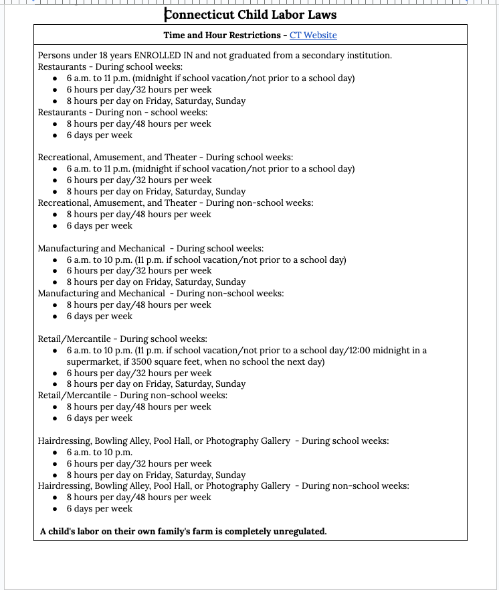
Model Strategy
Notes:
JAKE

Slide 32
Breakout # 2: Strategy Building
How can educators use Human Rights Education principles as tools to design learning opportunities that foster critical thinking and empathy rather than deepening ideological divides?
How can educational leaders (school boards, administrators, faculty senates) set policies that promote open dialogue and trust while resisting political or cultural pressure to censor or polarize?
What strategies can schools and colleges use to engage parents, families, and local communities in ways that bridge divides instead of reinforcing them?
Are there strategies/methods that should be avoided or re-considered when attempting to confront polarization?
Where might you see HRE applied/needing to be applied in your own context to confront polarization?

Slide 33

Breakout # 2: Strategy Building
We are going to split off into three small breakout groups
Please use the following mentimeter link and QR code to participate in the conversation
Each slide has one question. You have 200 characters to respond. You can click “Next Question” to proceed
Your group facilitator will give you time to respond to any of the questions you feel compelled to respond to, and then engage in a small group discussion
www.menti.com/alzo35dfo7ip

Slide 34
Full Group Debrief

Slide 35
Helpful Resources
Be MediaWise (PBS)
ICivics
Deliberative Democracy Lab
National Issues Forum
Learning For Justice

Slide 36



Stay Connected!
Receive our newsletter

Slide 37
Opportunities & Events
Training As Action Series 2025-2026
Next Session:
Intersectional Democracy: Race and Migration
Monday, January 26 at 7pm ET
Module 6:
REGISTER HERE
Become a Member Join A Team

Slide 38
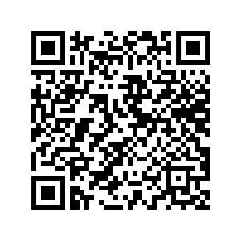
Evaluation and Parting Words

Slide 39
Open Conversation
What questions do you have after our session?
Are there ways in which Human Rights Educators USA and can assist you?
What are your wonder questions?

