Slide 1

Defending Democracy Through Human Rights Education
Notes:
SAAH

Slide 2
Check-In In The Chat:
Your Name
Your Role (i.e. Teacher, Student)
Institution and Location
One thing you’re looking forward to doing this fall (does not have to be human rights related)
Notes:
SAAH

Slide 3
Agenda
Welcome and Check-In
Group Expectations and Norms
Introduction to Human Rights Education
Pause & Quick Discussion
Threats to the Right to Education & Democracy
Small Group Strategy Building
Woven Teaching and Human Rights Educators USA
Evaluation and Parting Words
Notes:
SAAH

Slide 4

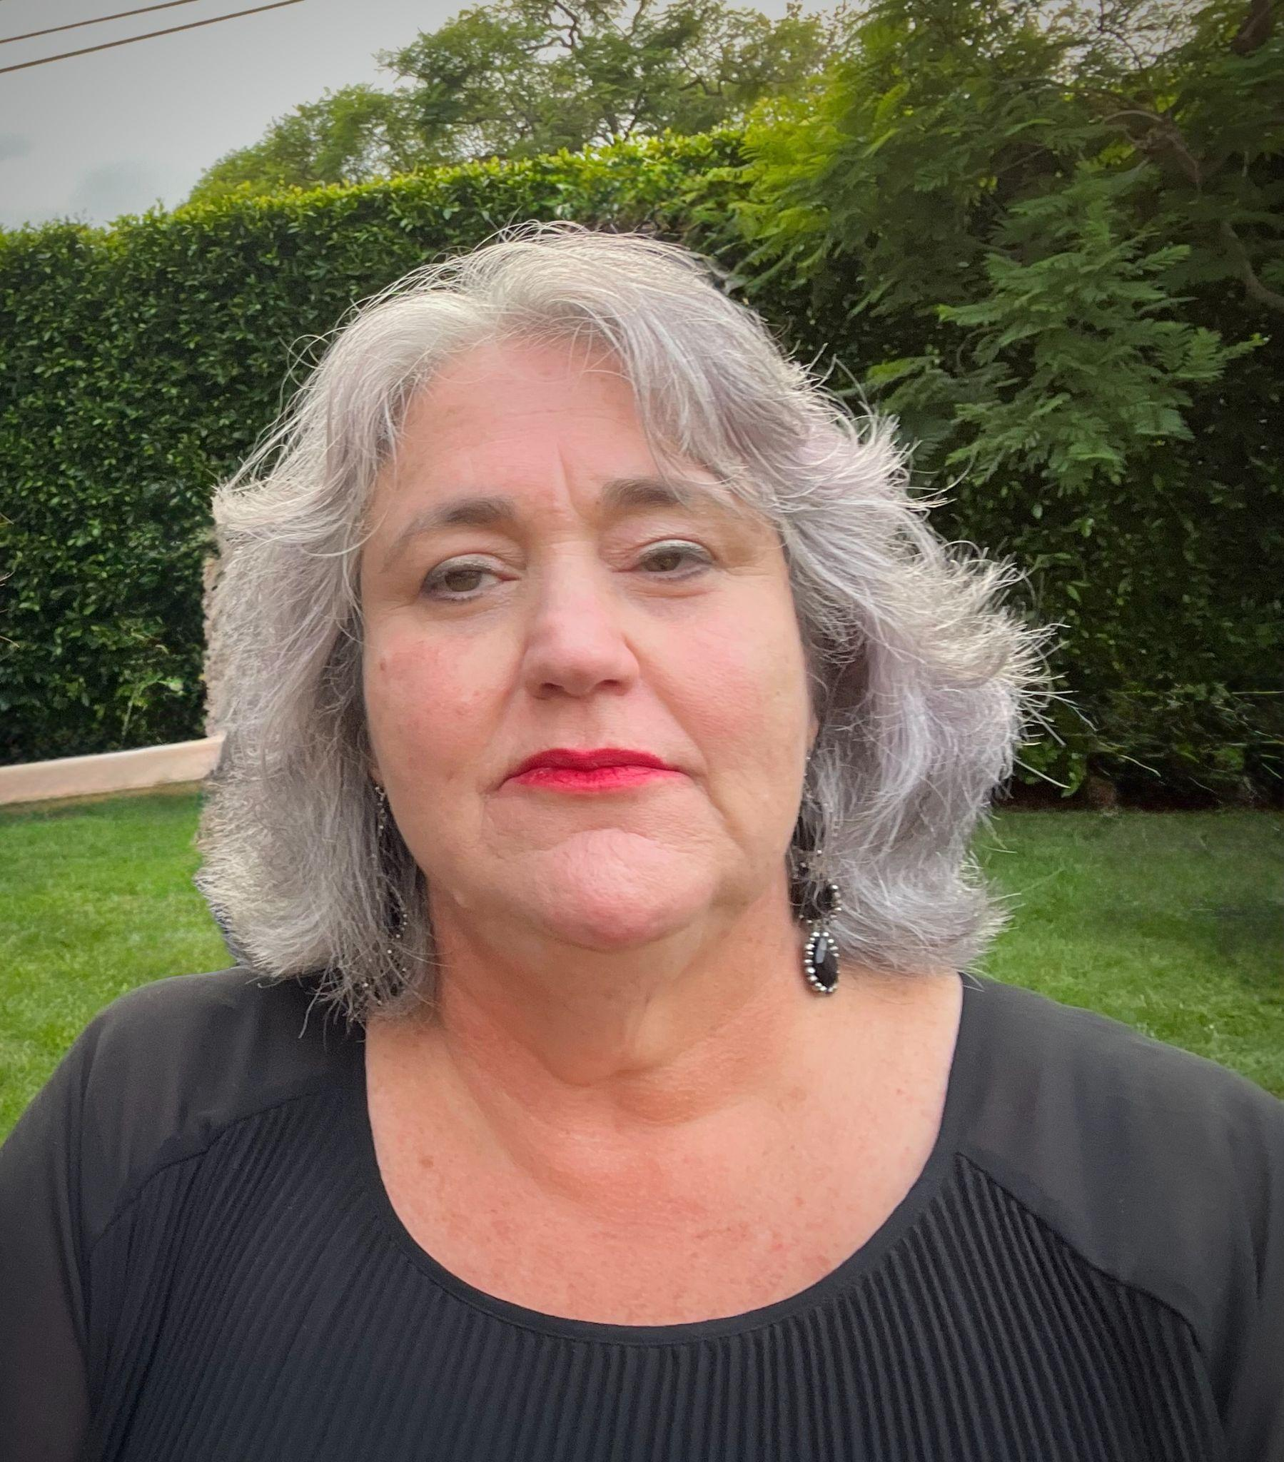
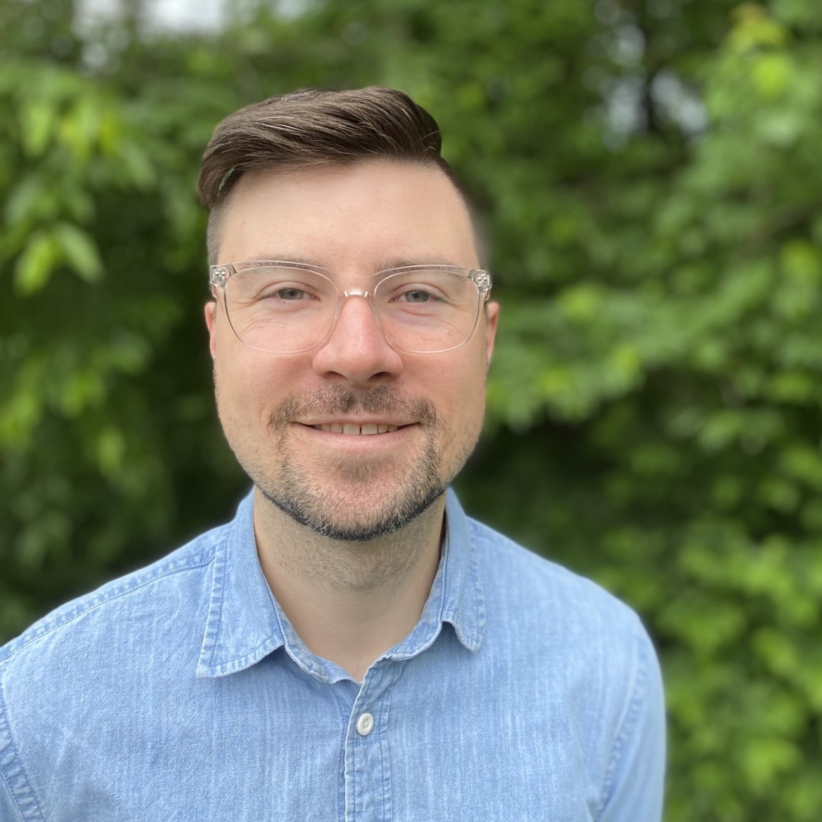
Facilitator Introductions:
Nina Simone Grotch
Director Human Right Education
Woven Teaching
Jake Skrzypiec
Social Studies Teacher, CT
Steering Committee, HRE USA
Saah Agyemang Badu
Human Rights Institute- UConn
Notes:
ALL

Slide 5

Group Expectations
Notes:
SAAH

Slide 6
Opening Question (In the chat)
On a scale from 1-10, how well acquainted are you with human rights education?
How have you used human rights education in your practice, work or personal life to date?
Notes:
NINA

Slide 7
What are Human Rights?
Human rights are the rights that every human has just for being human, and they are essential for a life of dignity.
They are:
  Equal & Universal
  Inalienable
  Interdependent
Notes:
JAKE

Slide 8
What is Human Rights Education?
A lifelong process of teaching and learning that helps individuals, groups, and communities:
  Develop the knowledge, skills, and values to fully exercise and protect their human rights and those of others;
  Fulfill their responsibilities in the context of internationally recognized human rights principles;
  Achieve justice and peace in the world.
Notes:
JAKE

Slide 9
HRE: About, Through & For
(a) Education about human rights, which includes providing knowledge and understanding of human rights norms and principles, the values that underpin them and the mechanisms for their protection;
(b) Education through human rights, which includes learning and teaching in a way that respects the rights of both educators and learners;
(c) Education for human rights, which includes empowering persons to enjoy and exercise their rights and to respect and uphold the rights of others” (UNDHRET, 2011).
Notes:
JAKE

Slide 10
Why is HRE important? Why should it be pursued?
Promotes values, beliefs and attitudes that encourage all individuals to uphold their own rights and those of others.
Develops an understanding of everyone's common responsibility to make human rights a reality in each community.
Constitutes an essential contribution to the long-term prevention of human rights abuses.
Represents an important investment in the endeavour to achieve a just society in which all human rights of all persons are valued and respected. (OHCHR)
Notes:
JAKE

Slide 11
“Everyone has the right to know, seek and receive information about all human rights and fundamental freedoms and should have access to human rights education and training,” (UN Declaration on HRET 2011, art. 1).
Convention of the Rights of Child (art. 4, art. 19., art. 29)
International Convention on the Protection of the Rights of Migrant Workers (art. 65)
UNESCO Constitution (art. 1)
Convention against Discrimination in Education (art. 5)
Geneva Conventions (multiple provisions)
Instruments by various regional bodies ( EU, OAS, AU, OSCE )
Sustainable Development Goals (Goal 4, Target 7)
Universal Declaration of Human Rights (art. 26 para. 2)
International Covenant on Economic, Social and Cultural Rights (art. 2, para 1., art. 13, para. 1)
International Covenant on Civil and Political Rights (art. 2)
International Covenant on the Elimination of All Forms of Racial Discrimination (art. 2, art. 7)
Convention on the Elimination of All Forms of Discrimination against Women ( art. 2, art .10(c))
Convention against Torture and Other Cruel, Inhuman and Degrading Treatment (art. 2, art. 10)
Notes:
JAKE

Slide 12
HRE and Other Categories
Citizenship Education
Peace Education
Social Justice Education
Notes:
JAKE

Slide 13
Discussion and Dialogue
How might you utilize human rights education in your own practice, work or personal life?
Describe any challenges/barriers you might come across in implementing human rights education into your work?
Notes:
JAKE

Slide 14
Threats to the Right to Education & Democracy
Current Challenges:
Government interference in the classroom, curricula, and on campus
Intrusion of religion into public education
Attacks on Diversity Equity and Inclusion (DEI)
Rewriting of history and denial of basic facts and truths and the spread of mis/disinformation
Denigration of the press and media
Limits on speech and expression
Scapegoating of historically marginalized peoples
Threats and violence against immigrant communities
Increasingly heated political climate of anger, insults, and bullying
Notes:
NINA-some of the issues impacting our schools. You may also recognize these as signs of authoritarianism and fascism. I'm sure you can name others. What are issues impacting your students and your classrooms? Please put those in the chat.

Slide 15
Threats to the Right to Education & Democracy
"To be truly radical is to make hope possible rather than despair convincing.”
Raymond Williams
Notes:
NINA-a key tactic of authoritarianism is to make people feel hopeless and that they are powerless to make change.

Slide 16
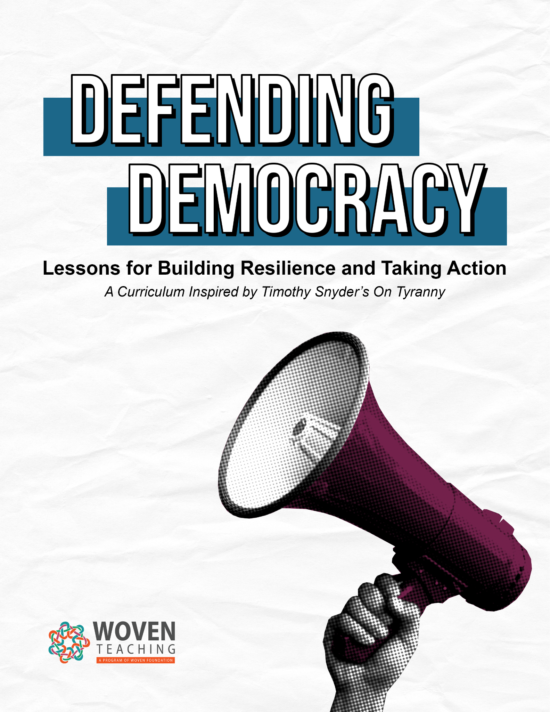

Defending Democracy
Notes:
NINA Why did we create this resource? Knowing that the political climate in the US has become increasingly splintered and fractious, how do we help students navigate this? We are also concerned with the very real dismantling of democratic practices and policies in the US and abroad. Our hope was to engage students with small actions that they can take individually and collectively to effect change. Timothy Snyder, a historian at Yale published On Tyranny as a response to the 2016 election. We used this book as a framework for our lessons. I will be talking a little later about some of Woven Teaching's other resources and materials.

Slide 17
Defending Democracy
Be kind to our language. Avoid pronouncing the phrases everyone else does. Think up your own way of speaking, even if only to convey that thing you think everyone is saying. Make an effort to separate yourself from the internet. Read books.
Believe in truth. To abandon facts is to abandon freedom. If nothing is true, then no one can criticize power because there is no basis upon which to do so. If nothing is true, then all is spectacle. The biggest wallet pays for the most blinding lights.
Investigate. Figure things out for yourself. Spend more time with long articles. Subsidize investigative journalism by subscribing to print media. Realize that some of what is on the internet is there to harm you. Learn about sites that investigate propaganda campaigns (some of which come from abroad). Take responsibility for what you communicate to others.
Learn from peers in other countries. Keep up your friendships abroad, or make new friends abroad. The present difficulties in the United States are an element of a larger trend. And no country is going to find a solution by itself. Make sure you and your family have passports.
Notes:
NINA Why did we create this resource? Knowing that the political climate in the US has become increasingly splintered and fractious, how do we help students navigate this? We are also concerned with the very real dismantling of democratic practices and policies in the US and abroad. Our hope was to engage students with small actions that they can take individually and collectively to effect change. Timothy Snyder, a historian at Yale published On Tyranny as a response to the 2016 election. We used this book as a framework for our lessons. I will be talking a little later about some of Woven Teaching's other resources and materials.

Slide 18
Defending Democracy
Resources to teach about democracy and authoritarianism in both historical and contemporary contexts
3 introductory lessons and 12 interactive lessons based on Snyder's On Tyranny: Twenty Lessons from the Twentieth Century
A human rights-based framework to examine local, national, and global issues
Additional resources for continued learning and engagement
Practical suggestions for empowering students and participants to become human rights defenders
Notes:
NINA-…, which identified 12 of these lessons and turned them into this curriculum of 15 lessons for the secondary level classroom.
In addition to teaching students small actions that they can take to make change, the curriculum also offers inspirational examples from the global and historical struggles to protect democracy.
Our goal was to offer this curriculum as a way of turning despair into informed action. We created this resource because our hope is to give students the information and opportunities to engage them in small actions that they can take to effect change.
We created this because we know that education is a critical element in protecting democracy. As iCIVICS – the nonprofit group focused on civics education and an active citizenry – says, “The best way to protect democracy is to teach it.”

Slide 19
Strategies for Standing Up
Nina Jake Saah
Notes:
NINA

Slide 20
Small Group Strategy Building
Guiding Questions:
Describe any human rights action strategies you have utilized in your work?
What ideas or inspiration have been percolating that you want to try out?
Where have you found hope and a sense of resilience? (Think about your work/professional life, or your personal life)
Notes:
NINA

Slide 21

Woven Teaching
Woven Teaching exists to reduce obstacles for educators, in both traditional and non-traditional settings, to effectively teach about human rights and to support their learners in becoming part of an engaged, active global citizenry advocating for and protecting universal human rights. We believe that personal knowledge or access to resources should not be a limiting factor in an educators’ ability to teach about universal human rights and to support students to be human rights defenders.
Notes:
NINA-
In addition to teaching students small actions that they can take to make change, the curriculum also offers inspirational examples from the global and historical struggles to protect democracy.
Our goal was to offer this curriculum as a way of turning despair into informed action. We created this resource because our hope is to give students the information and opportunities to engage them in small actions that they can take to effect change.
We created this because we know that education is a critical element in protecting democracy. As iCIVICS – the nonprofit group focused on civics education and an active citizenry – says, “The best way to protect democracy is to teach it.”

Slide 22
Woven Teaching
Practical help for teaching ethically & effectively
Free and accessible lessons for educators that highlight our global connectedness and examples of human rights defenders in action
Timeline of Human Rights History
Online and in-person workshops for educators
Human Rights Education
Resources with historical and contemporary perspectives and geographic diversity
Notes:
NINA-
In addition to teaching students small actions that they can take to make change, the curriculum also offers inspirational examples from the global and historical struggles to protect democracy.
Our goal was to offer this curriculum as a way of turning despair into informed action. We created this resource because our hope is to give students the information and opportunities to engage them in small actions that they can take to effect change.
We created this because we know that education is a critical element in protecting democracy. As iCIVICS – the nonprofit group focused on civics education and an active citizenry – says, “The best way to protect democracy is to teach it.”

Slide 23
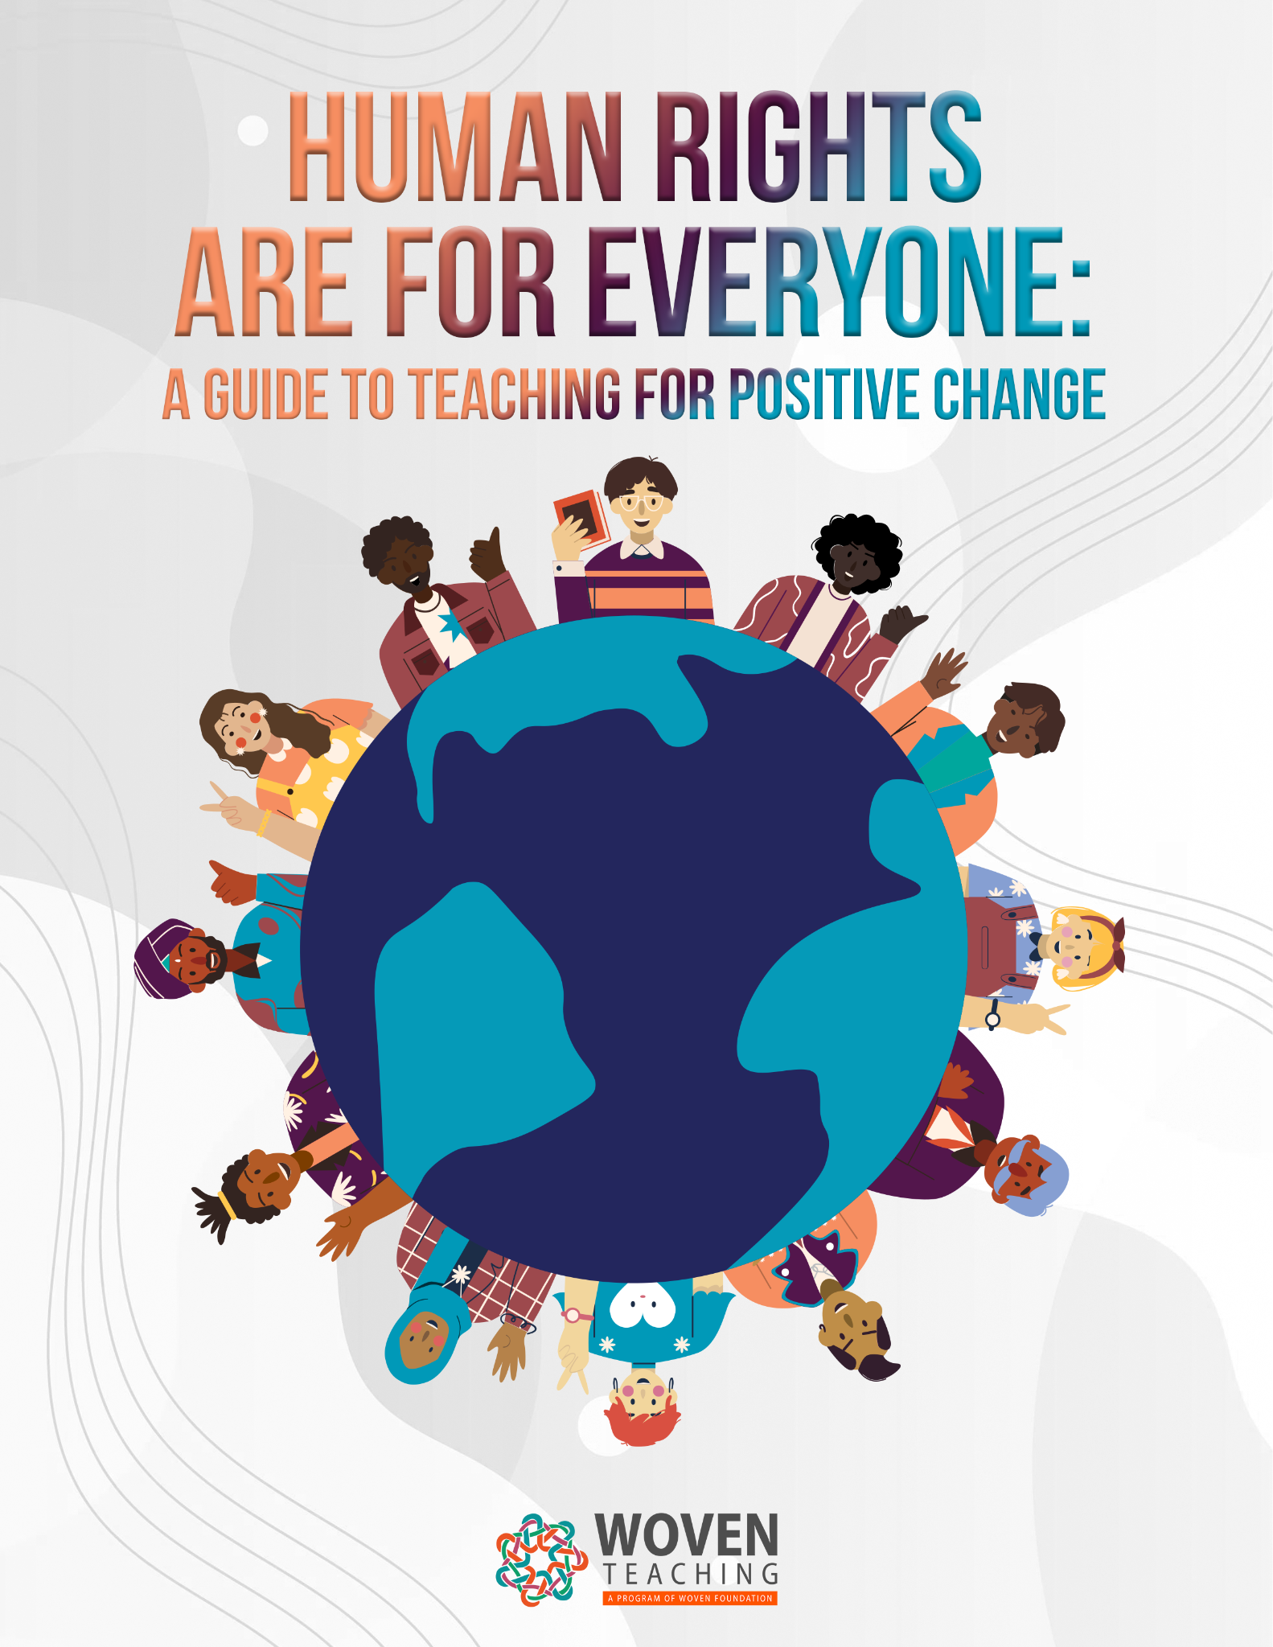
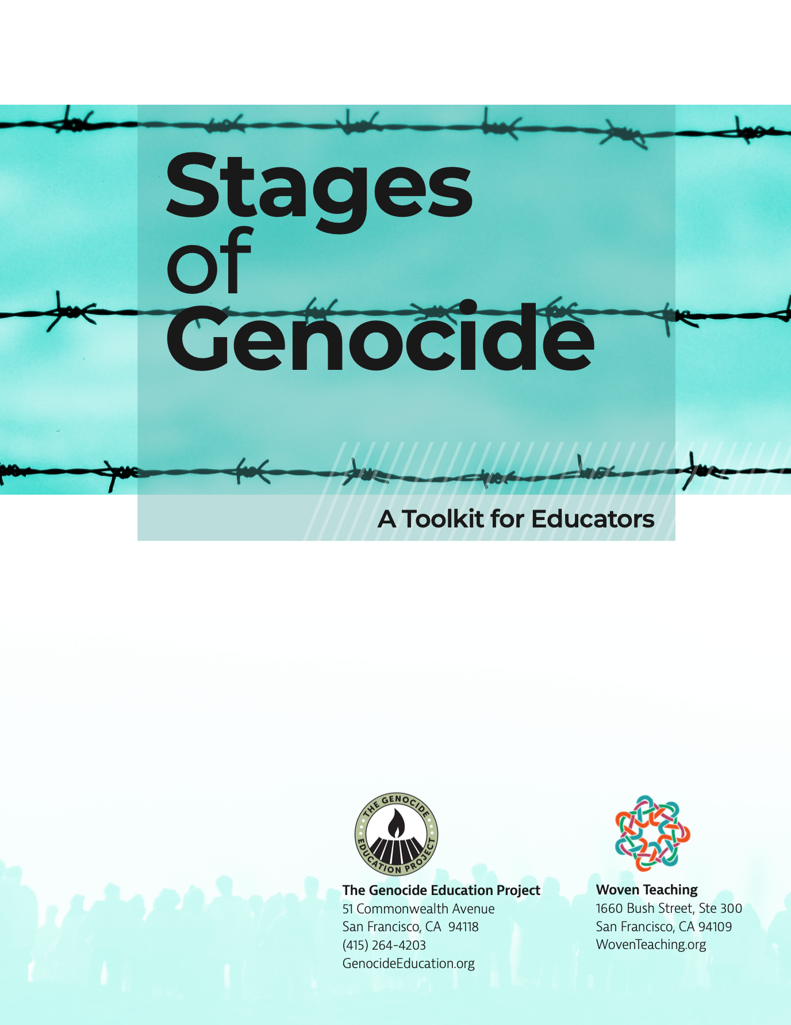
Woven Teaching
Notes:
NINA-…,One of the primary things we do at Woven Teaching is create lessons and curricula. These three make up the 3 pillars of our work. The first, Human RIghts are for Everyone is a practical guide to teaching about human rights. Defending Democracy is about holding the line and fighting authoritarianism. Lastly, genocide is a central issue for us as well. Stages of Genocide is a resource that we created with the Genocide Education Project. This guide uses Professor Gregory Stanton’s 10 stages of genocide to discuss case studies taken from different instances of mass atrocity and genocide.
In addition to teaching students small actions that they can take to make change, the curriculum also offers inspirational examples from the global and historical struggles to protect democracy.
Our goal was to offer this curriculum as a way of turning despair into informed action. We created this resource because our hope is to give students the information and opportunities to engage them in small actions that they can take to effect change.
We created this because we know that education is a critical element in protecting democracy. As iCIVICS – the nonprofit group focused on civics education and an active citizenry – says, “The best way to protect democracy is to teach it.”

Slide 24

Woven Teaching Resources
Notes:
NINA-
In addition to teaching students small actions that they can take to make change, the curriculum also offers inspirational examples from the global and historical struggles to protect democracy.
Our goal was to offer this curriculum as a way of turning despair into informed action. We created this resource because our hope is to give students the information and opportunities to engage them in small actions that they can take to effect change.
We created this because we know that education is a critical element in protecting democracy. As iCIVICS – the nonprofit group focused on civics education and an active citizenry – says, “The best way to protect democracy is to teach it.”

Slide 25
Overview of Human Rights Educators USA
Notes:
JAKE, all the way through till Evaluation and Parting Words

Slide 26
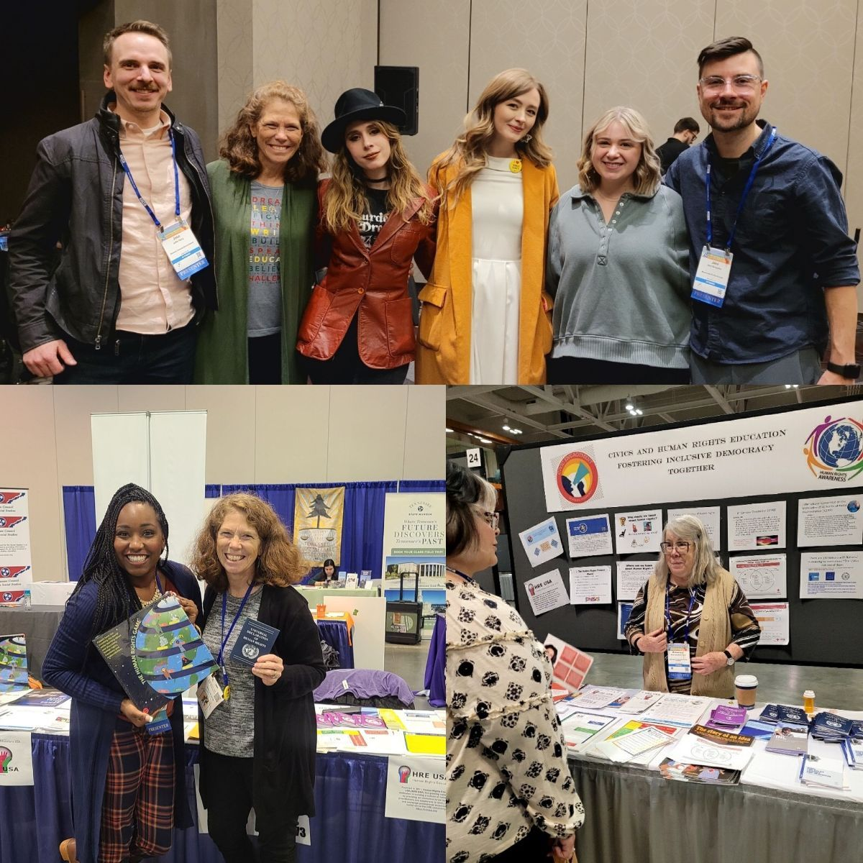
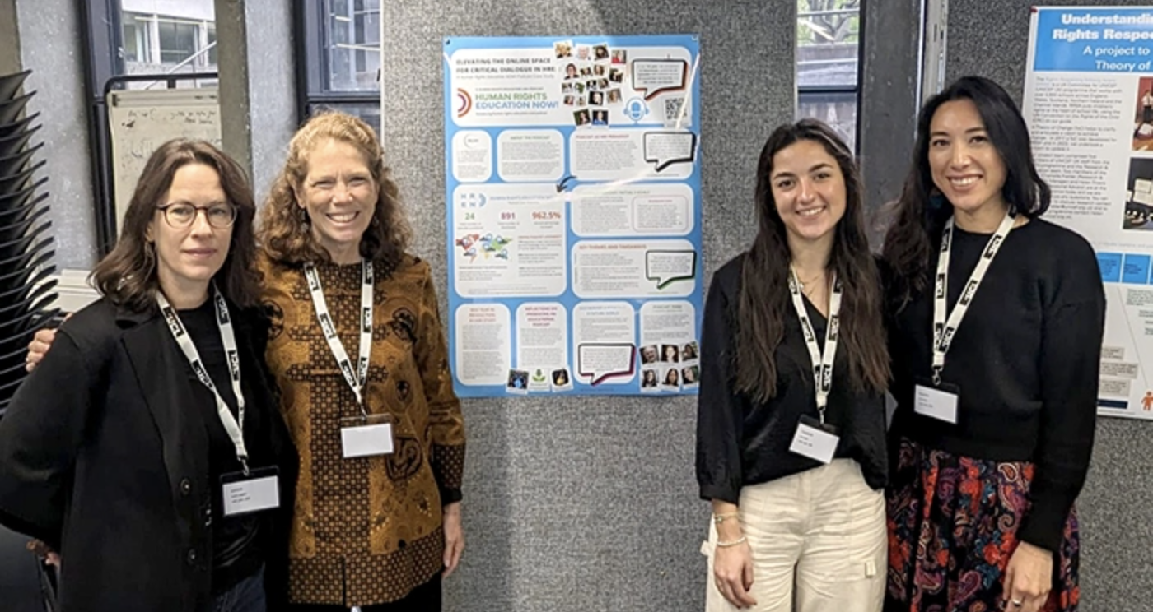
Our Mission
Human Rights Educators USA (HRE USA) is a collaborative network to learn, teach, organize, advocate, and innovate for human rights education in the United States.

Slide 27
Our Mission
To fulfill our mission, HRE USA works to:
Integrate human rights standards
Promote national and regional policies that support HRE
Advocate for inclusion of HRE in standards, curricula, and pedagogy
Develop resources and training for educators
Contribute to global research and scholarship
Empower educators and learners
Participate in global networks and forums to share best practices

Slide 28
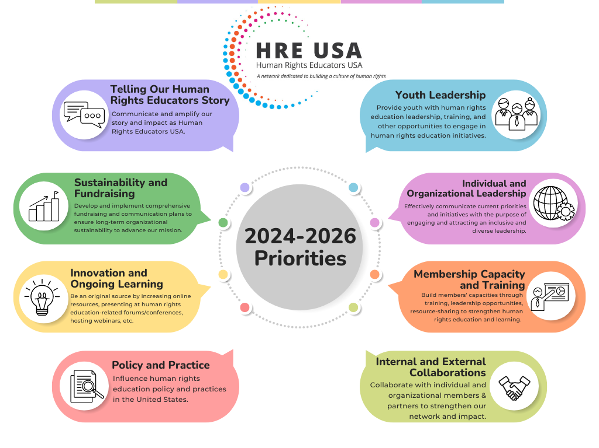
HRE USA 2024-2026 Priorities

Slide 29
Action Teams
Advocacy and Policy Team
Awards, Recognitions and Special Events Team
Fellowships, Internships and Professional Support Team
Innovations and Partnerships Team
Membership & Sustainability Team
Podcast Team
Professional Development and Training Team
Regional Representative Team
Strategy and Priorities Team

Slide 30

Regional Outreach: Regional Representatives Structure
Regional Representative Chapters are divided into four organizing regions:
Midwest
Northeast
South
West
Each HRE USA chapter has one or two regional representatives who coordinate human rights education activities and engages with members and organizational partners in their areas.

Slide 31

Regional Outreach: Regional Representatives

Slide 32

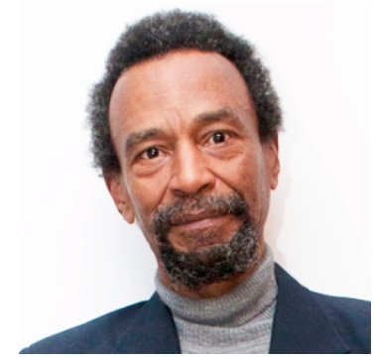
Kirby Edmonds’ Work & Legacy

Slide 33
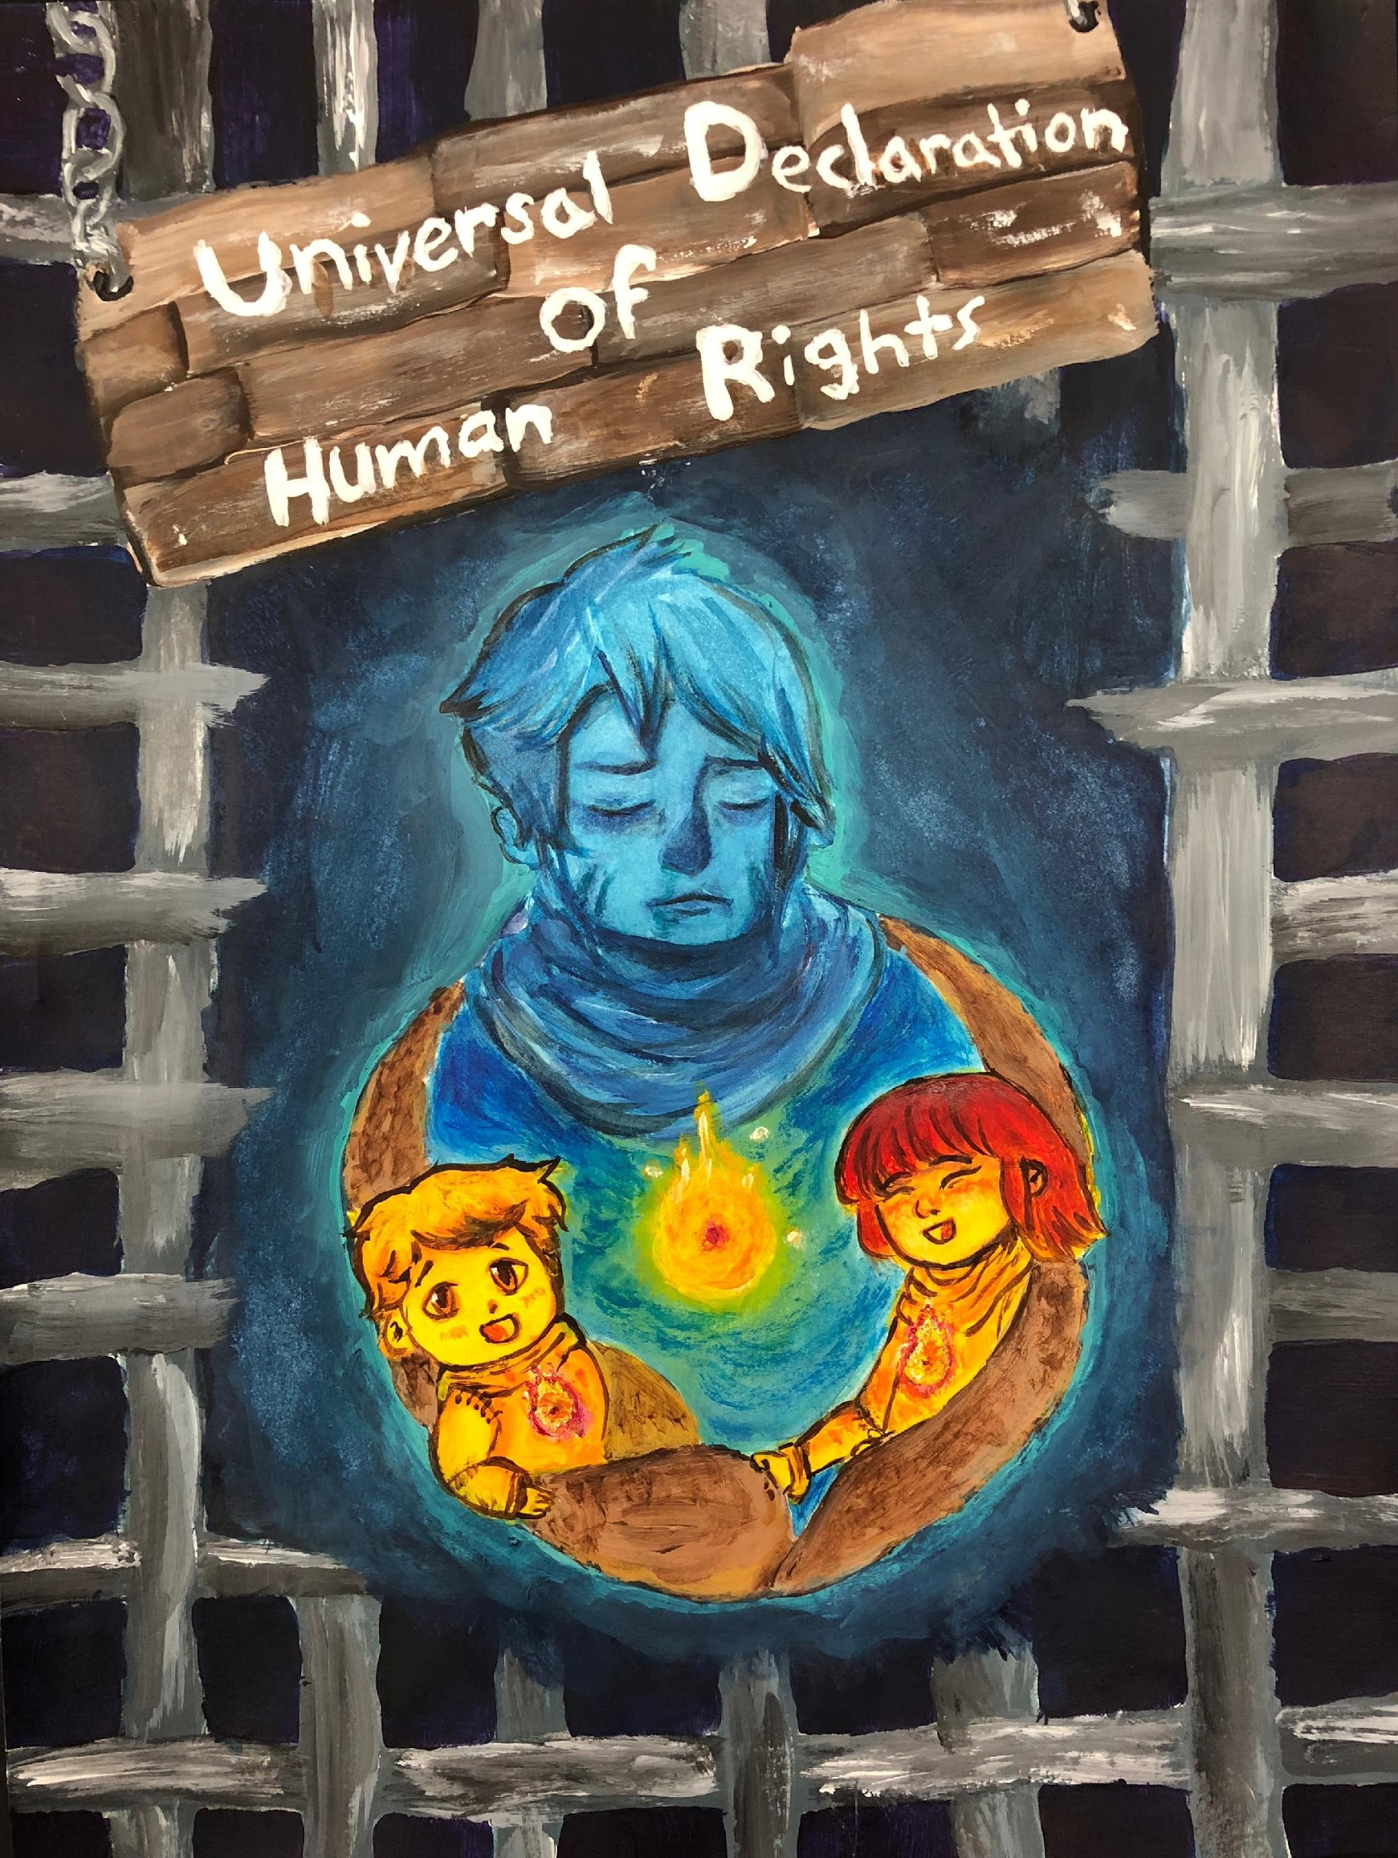
Communications and Forum
E-Newsletter
Discussion Forum
Blog and Social Media Posts
** LinkedIn, Facebook, Twitter, Instagram
Podcast
Membership Profiles
Human Rights Here & Now Toolkits
HRE and Linkages Briefs
Annual Reports
Artist: Judy Nao

Slide 34
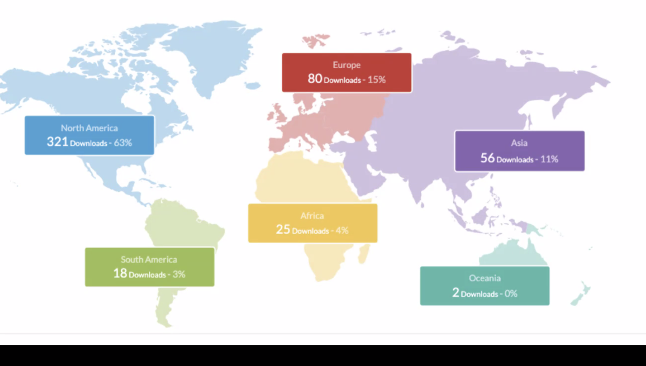

Human Rights Education Now!
HRE USA Podcast
Links: Buzzsprout and HREUSA

Slide 35
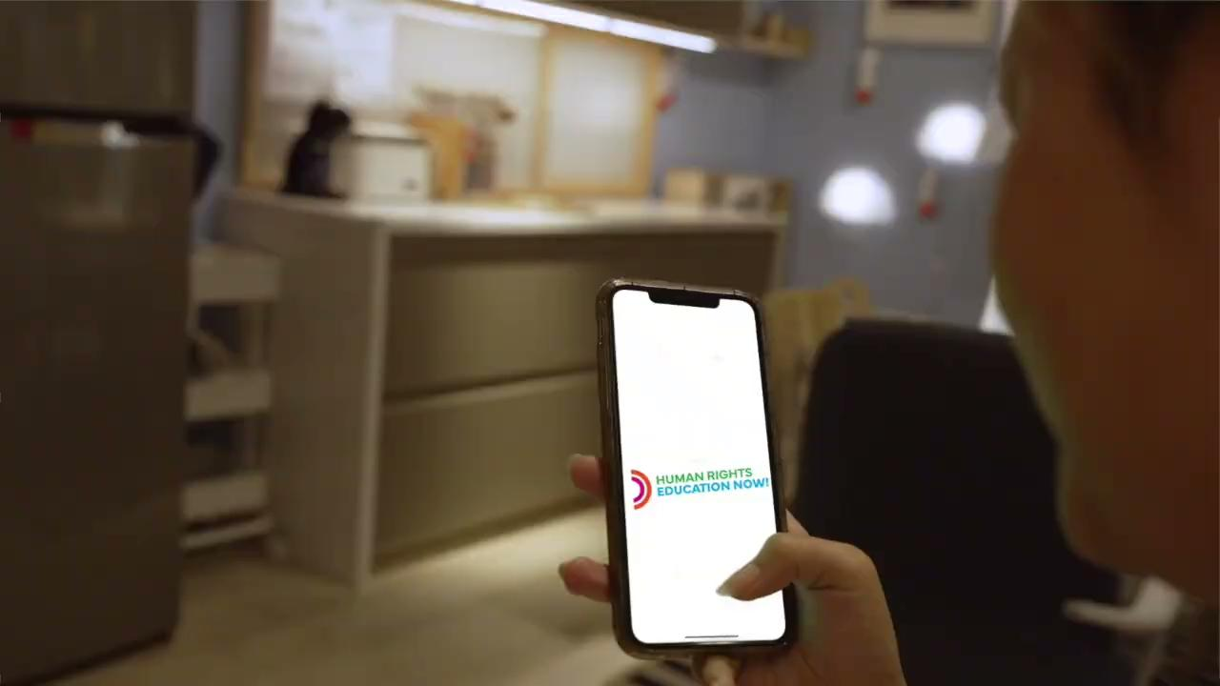


Slide 36


Project Examples

Slide 37
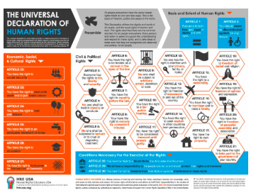
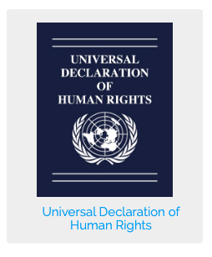
HRE USA Online Shop

Slide 38




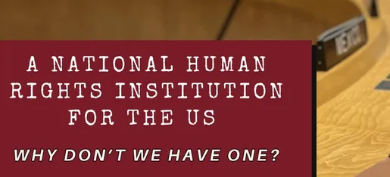
Association and Organizational Partnerships

Slide 39



Stay Connected!
Receive our newsletter

Slide 40
Opportunities & Events
Training As Action Series 2025-2026
Next Session: Monday September 29th @ 7:00 pm
Youth Civic Power: Mobilizing for Rights and Democracy
Become a Member
Join A Team

Slide 41
Facilitator Contact Info:
Nina Simone Grotch
Director of Human Rights Education
nina@woventeaching.org
www.woventeaching.org
Jake Skrzypiec
Social Studies Teacher, CT
Steering Committee,
HRE USA
jacob.skrzypiec@gmail.com

Slide 42
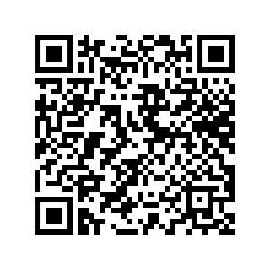
Evaluation and Parting Words

Slide 43
Open Conversation
What questions do you have after our session?
Are there ways in which Human Rights Educators USA and Woven Teaching can assist you in your practice of human rights education?
What are your wonder questions?

