Slide 1

MODULE 5: DIGITAL CITIZENSHIP & HUMAN RIGHTS IN THE AGE OF DISINFORMATION
HREUSA TAAS SERIES
Nina Simone Grotch
Woven Foundation
Felisa Tibbitts
HREA/Utrecht University

Slide 2
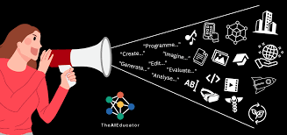
Thematic Overview of the Webinar
AI and Human Rights Literacy
Algorithms and bias
Youth-centered actions to combat dis/misinformation
Actions to promote digital citizenship

Slide 3
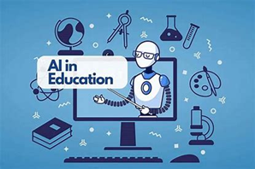
Quick Poll
How enthusiastic would you say you are about using AI?
What is your experience in using AI?
Go to: https://www.menti.com/alf1htjcbc2h
Join at menti.com | use code 7609 6041

Slide 4


Slide 5

AI is Here to Stay
The rapid advancement of artificial intelligence (AI) technology is presenting one of the most profound opportunities and challenges for humanity in the 21st century.
While advocates are enthusiastic about AI's immense potential to enhance efficiency, automation, and data-driven decision-making, a rising chorus of voices is sounding the alarm about AI's existential risks to fundamental human rights, democratic values and education.

Slide 6

AI in Education
Notably, the domain of education has emerged as a particularly high-stakes arena for upholding human rights in the age of AI.
Given education's vital role in cultivating future generations of engaged citizens and leaders, schools and universities must ensure AI's positive impact while mitigating its threats takes on heightened importance.

Slide 7

NARROW AI FOCUSES ON PERFORMING SPECIFIC TASKS, LIKE RECOGNIZING YOUR VOICE WHEN YOU CHAT WITH SIRI. THIS TYPE OF AI HAS A LIMITED CONTEXT, WITH NO BROADER UNDERSTANDING OR AWARENESS (STRONG AI).
CURRENTLY, NARROW AI IS THE MOST ADVANCED FORM OF AI WE HAVE. GENERATIVE AI IS CAPABLE OF GENERATING TEXT, IMAGES, VIDEOS, OFTEN IN RESPONSE TO PROMPTS.
Narrow AI

Slide 8
Educators/Administrators’ use of AI
- curriculum development, assessment
- monitoring student performance, involving digitalization of personal data
- prediction of funding needs
- Review of admission applications
Students’ use of AI
- online personalized learning systems for students
- research and writing
AI Use in Formal Education

Slide 9
* RIGHT TO EDUCATION
* RIGHT TO EQUALITY
* RIGHT TO PRIVACY
* BIAS AND DISCRIMINATION
* RIGHT TO WORK AND LIVELIHOOD
* RIGHT TO FREEDOM OF THOUGHT AND EXPRESSION
* RIGHT TO DEMOCRATIC PARTICIPATION
Human Rights at Stake with AI

Slide 10
Woven Teaching is the programmatic arm of Woven Foundation. Through a combination of original programming and grantmaking, Woven Teaching advances Woven Foundation’s focus on long-term change towards a widespread acceptance of basic human rights for all.
We believe that education is critical to supporting democracy and to upholding and protecting human rights. Woven Teaching exists to reduce the barriers for educators, in both traditional and non-traditional settings, to effectively teach about human rights and support their learners to become part of this engaged, active global citizenry.
We provide:
Free and accessible lessons for educators
Online and in-person workshops
Historical and contemporary perspective
Global connectedness and real life examples of human rights defenders in action
Notes:
Why did we create this resource? Knowing that the political climate in the US has become increasingly splintered and fractious, how do we help students navigate this? We are also concerned with the very real dismantling of democratic practices and policies in the US and abroad. Our hope was to engage students with small actions that they can take individually and collectively to effect change. Timothy Snyder, a historian at Yale published On Tyranny as a response to the 2016 election. We used this book as a framework for our lessons.

Slide 11
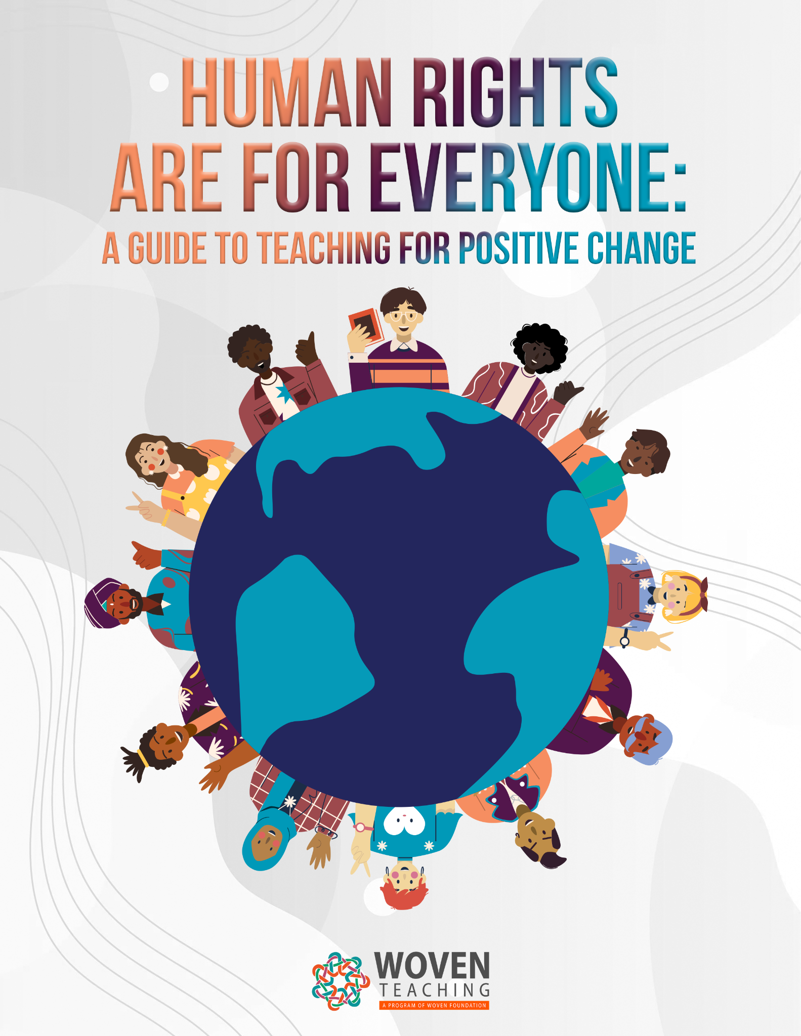
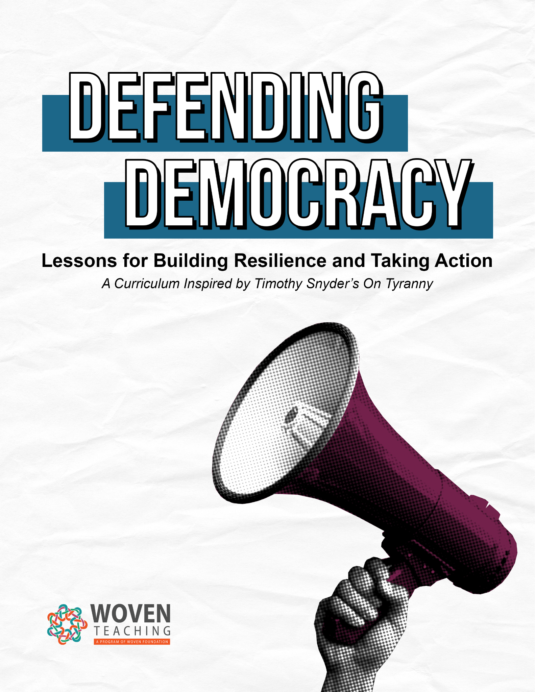
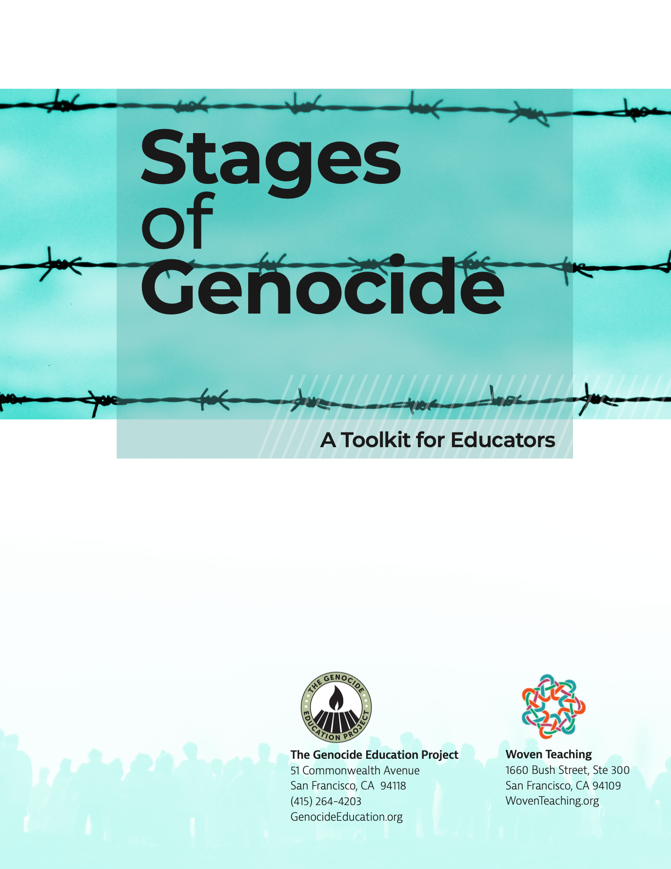
Three Pillars of Woven Teaching
Human Rights Are for Everyone
Defending Democracy
Stages of Genocide
Notes:
One of the primary things we do at Woven Teaching is create lessons and curricula. These three make up the 3 pillars of our work. The first, Human RIghts are for Everyone is a practical guide to teaching about human rights. Defending Democracy is about holding the line and fighting authoritarianism. Lastly, genocide is a central issue for us as well. Stages of Genocide is a resource that we created with the Genocide Education Project. This guide uses Professor Gregory Stanton’s 10 stages of genocide to discuss case studies taken from different instances of mass atrocity and genocide.

Slide 12

Notes:
Why did we create this resource? Knowing that the political climate in the US has become increasingly splintered and fractious, how do we help students navigate this? We are also concerned with the very real dismantling of democratic practices and policies in the US and abroad. Our hope was to engage students with small actions that they can take individually and collectively to effect change. Timothy Snyder, a historian at Yale published On Tyranny as a response to the 2016 election. We used this book as a framework for our lessons.

Slide 13
Algorithms and Impact
Lesson 6: Be Kind to Our Language: Expand Your Worldview
How TikTok's Algorithm Figures You Out |
Wall Street Journal
Notes:
One of the primary things we do at Woven Teaching is create lessons and curricula. These three make up the 3 pillars of our work. The first, Human RIghts are for Everyone is a practical guide to teaching about human rights. Defending Democracy is about holding the line and fighting authoritarianism. Lastly, genocide is a central issue for us as well. Stages of Genocide is a resource that we created with the Genocide Education Project. This guide uses Professor Gregory Stanton’s 10 stages of genocide to discuss case studies taken from different instances of mass atrocity and genocide.

Slide 14
Algorithms and Impact
What kind of content do you see most often on your social media accounts? Do you follow the creators of this content, or does most of it “just show up” in your social media feed?
What are the benefits of social media platforms using an algorithm to only serve you content you will engage with? What are the drawbacks?
Even without listening to your microphone or reading your messages, TikTok (and other platforms) have a lot of information about you and your interests. Do you feel comfortable with this? Why or why not?
How might algorithms like this be harmful to society as a whole? How might they support the growth of authoritarianism?
Notes:
One of the primary things we do at Woven Teaching is create lessons and curricula. These three make up the 3 pillars of our work. The first, Human RIghts are for Everyone is a practical guide to teaching about human rights. Defending Democracy is about holding the line and fighting authoritarianism. Lastly, genocide is a central issue for us as well. Stages of Genocide is a resource that we created with the Genocide Education Project. This guide uses Professor Gregory Stanton’s 10 stages of genocide to discuss case studies taken from different instances of mass atrocity and genocide.

Slide 15
“Believe in truth. To abandon facts is to abandon freedom. If nothing is true, then no one can criticize power, because there is no basis upon which to do so. If nothing is true, then all is spectacle. The biggest wallet pays for the most blinding lights.”
On Tyranny, Chapter 10 (p. 65)
Notes:
Why did we create this resource? Knowing that the political climate in the US has become increasingly splintered and fractious, how do we help students navigate this? We are also concerned with the very real dismantling of democratic practices and policies in the US and abroad. Our hope was to engage students with small actions that they can take individually and collectively to effect change. Timothy Snyder, a historian at Yale published On Tyranny as a response to the 2016 election. We used this book as a framework for our lessons.

Slide 16
Resources for Youth
Key Questions to Ask When Analyzing Key Media Experiences
National Association for Media Literacy Education
Notes:
Why did we create this resource? Knowing that the political climate in the US has become increasingly splintered and fractious, how do we help students navigate this? We are also concerned with the very real dismantling of democratic practices and policies in the US and abroad. Our hope was to engage students with small actions that they can take individually and collectively to effect change. Timothy Snyder, a historian at Yale published On Tyranny as a response to the 2016 election. We used this book as a framework for our lessons.

Slide 17
Youth-Centered Action
Examine the source
Lateral reading
Find the original clip
Keyword search
Mediawise:
Teen Fact-Checking Network

Slide 18

Promoting Digital Citizenship
Digital citizenship is the ability to use technology responsibly, safely and respectfully. It refers to the ability to protect private information online, mitigate risks associated with cyberthreats and utilize information in a respectful, knowledgeable and legal way. (Learning.com)
Watch video on Digital Citizenship:
Digital Citizenship | Things Explained (4:40)
Notes:
Other half– different photo? Or map like slide 4?

Slide 19
Promoting Digital Citizenship
The UN Secretary-General has stated the importance of making human rights the foundation of an open, safe and secure digital future. The digital environment[1] affords new opportunities for the realization of child and youth rights, such as ensuring their participation at the local, national and international levels, but also poses the risks of violation or abuse of those rights. (General Assembly resolution 78/187, para. 32.)
Fifth phase (2025-2029) targets: Youth, including children, as priority sectors, human rights and digital technologies, the environment and climate change, and gender equality and to align the fifth phase with the 2030 Agenda for Sustainable Development.
Notes:
Other half– different photo? Or map like slide 4?

Slide 20

Thank you for your attention!
Nina Simone Grotch
nina@wovenfoundation. org
Felisa Tibbitts
f.l.tibbitts@uu.nl

