Slide 1
Table of Contents
Slides 2-6 should be delivered on Day 1. Introduce the concept of Socratic seminar, and close with the Colin Kaepernick Jr. Scholastic article.
Have students answer the questions on the slide on a separate sheet of paper.
Slides 7, 8, 9 should be used for Days 2-3. Introduce the discussion question for the Socratic seminar. Show students the requirements for their documents, and then have students choose the documents they want to analyze using the graphic organizers attached in the Zip File.
Slide 10 will be delivered after the final Socratic as a means of closure. This will be the reflection writing piece. Students should be prompted that the reflections should be 4-5 sentences per question.

Slide 2
Day 1: Do Now--
- Take a Socratic Seminar sheet from the front table.
- Clear your desks of everything except your notebooks, something to write with and your sheet.
- Wait for instructions.
Notes:
Last Day

Slide 3
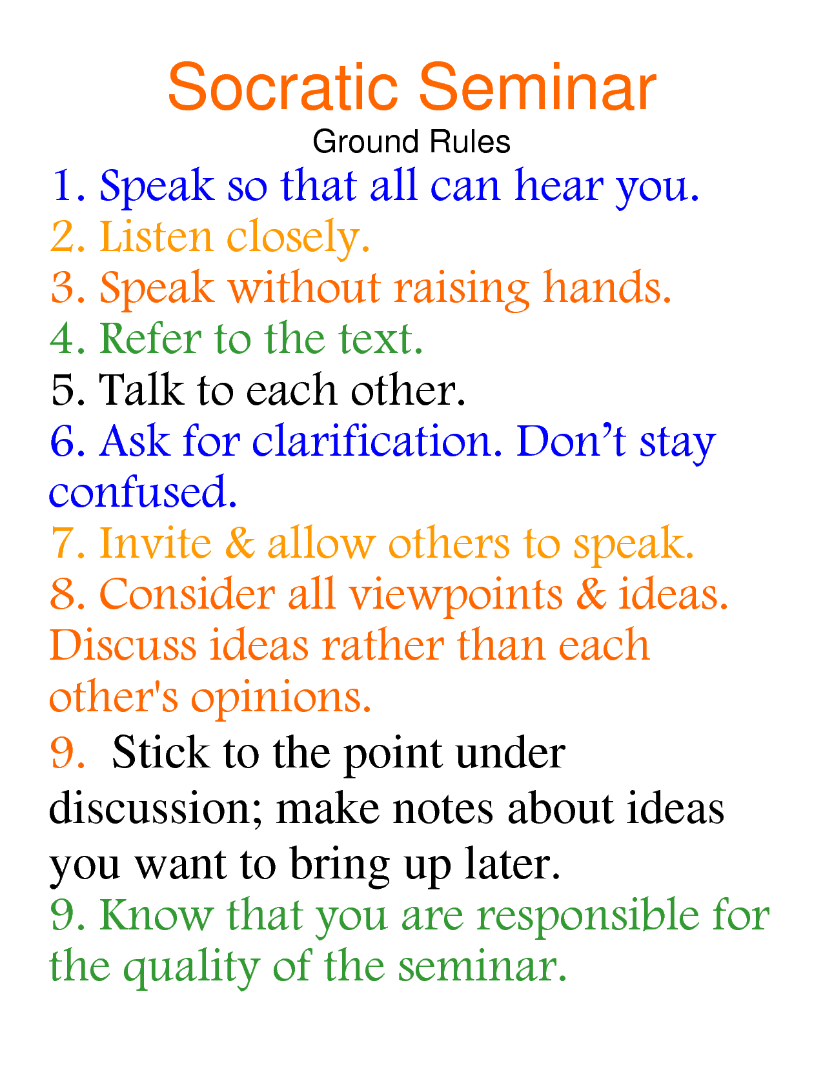
Socratic Seminar! https://www.youtube.com/watch?v=6pGVR6ZF_2M
- A Socratic Seminar is a formal, intellectual discussion between a group of educated people on the same topic.
- It is NOT a debate. The purpose is to increase everyone’s understanding of the topic, NOT to persuade and argue with one another.

Slide 4
What is acceptable in a Socratic Seminar (Write down everything in yellow)!
- Starting your sentences with:
I agree/disagree with…
I didn’t understand…
What would be the alternative…
Can anyone explain to me…
These are great ways to ensure that the conversation stays respectful and constructive.
Ask questions!
- You should always have questions prepared for the conversation.
Backup everything you say by referring to the text(s):
- Use the resources provided to back up your claims! Just like the DBQ!

Slide 5
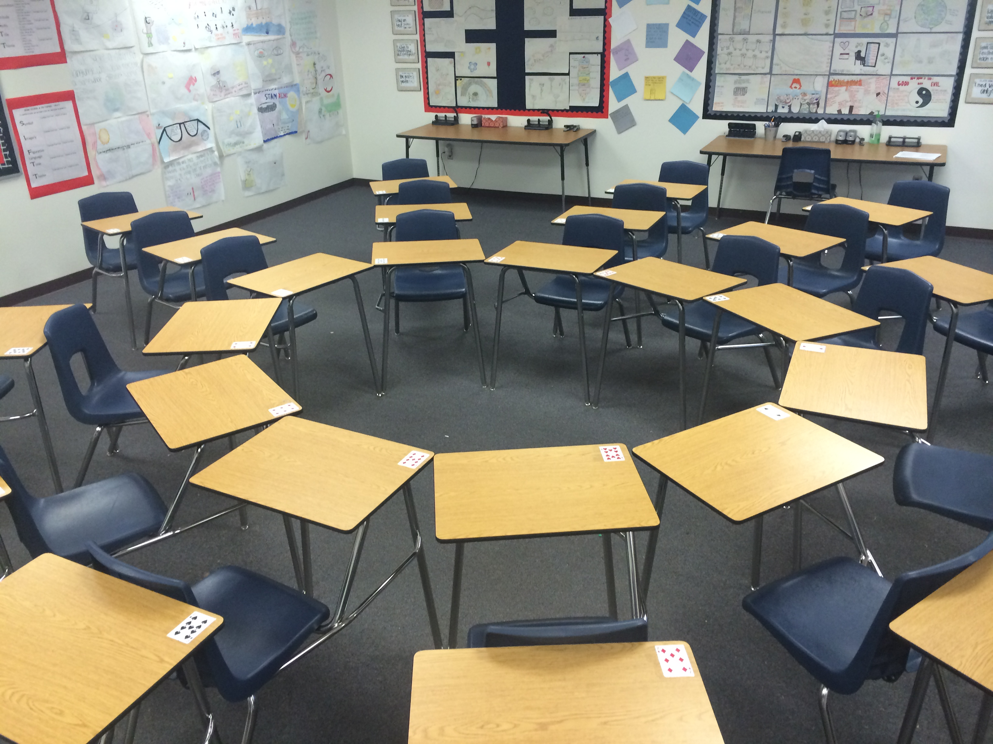

Classroom Setup
- There will be two circles:
The inner circle will be the one that is having the discussion.
The outer circle will be evaluating and taking notes on the inner circle.
The outer circle will have the “hot seat.” This is where they can ask one question or comment during the inner circle’s conversation.

Slide 6
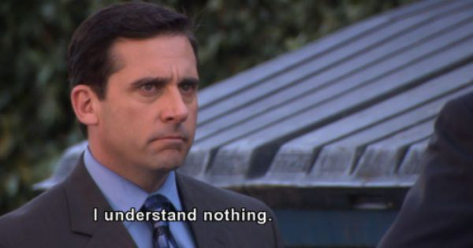
Questions for Discussion: (Day 1 Closer)
- What was your take on the article? Give a summary of what you read.
- What was the part of this article that struck you the most?
- Before we do any research, based on this article, are you for or against the First Amendment being expanded to protect citizens from private organizations as well as the government?
Notes:
Discussion Questions after reading the Colin Kaepernick article “Anthem Uproar.”

Slide 7
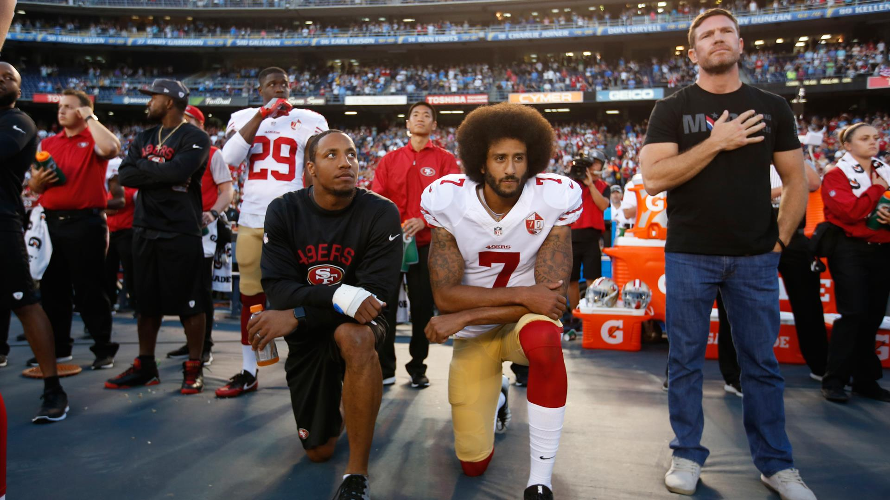
Topic of Conversation: Should the First Amendment be expanded to protect citizens from private organizations?

Slide 8
Requirements
1 video
1 social media post
2 political cartoons
2 quotes/articles
Video titles:
YouTube: Fox News: Sheriff Clarke on Colin Kaepernick 3:00 minutes
The Young Turks: The REAL Reason Colin Kaepernick does not have a Job
Notes:
Day 2-3: Resources Research

Slide 9
Question Maker’s Checklist
- The question is open-ended (no “yes” or “no” questions)
- Draws out differing opinions.
- Encourages connections to real-life experiences.
- Encourages higher order thinking (How? Why? questions).
- Makes people interested in others’ perspectives.
- Simple and clearly stated.
“Can freedom of speech go too far?”
Notes:
Day 4: Question Creation

Slide 10
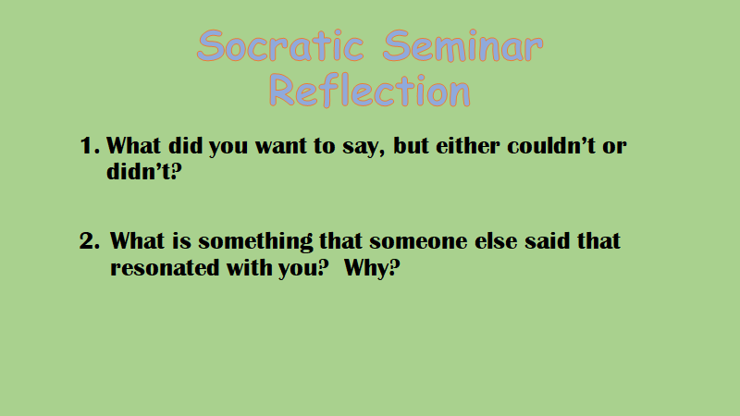
Notes:
Last Day: This will be administered after the Socratic Seminar.

