Slide 1

South Africa’s Constitution
Do Now: How are human rights guaranteed in the United States?
Essential Question: What are our human rights ideals, and what is Africa doing to achieve them?

Slide 2
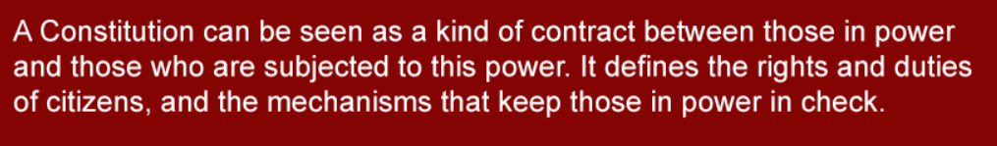

Slide 3
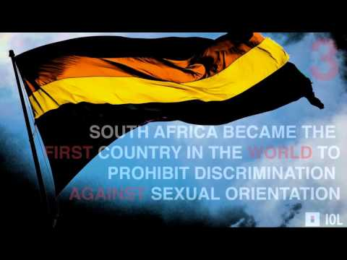
Which fact did you find the most interesting?

Slide 4
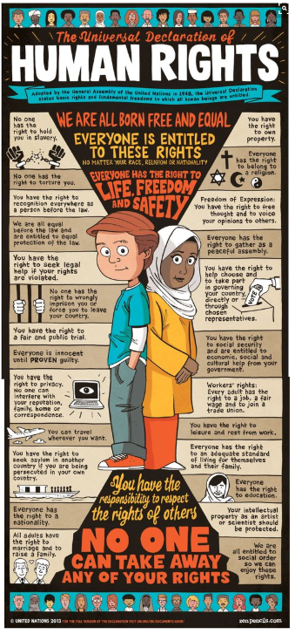
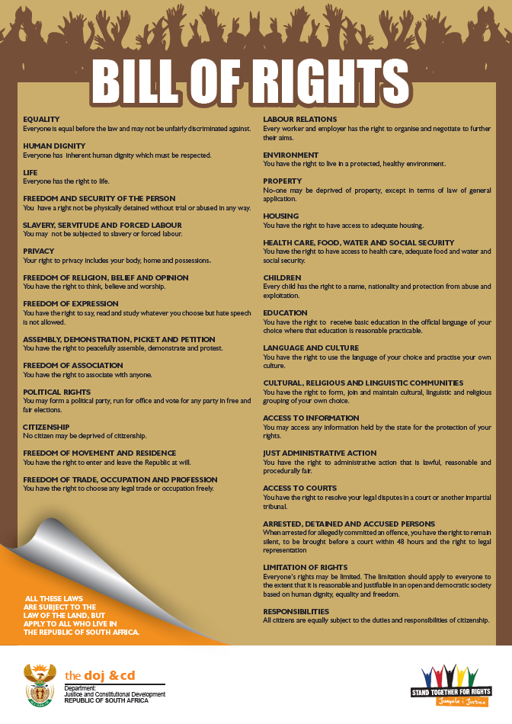
How are the 2 documents similar?
How are they different?

Slide 5
Find your group and circle it in the Graphic 1 Organizer
Housing | LGBT& Rights | Education | Water

Slide 6
Find your group and circle it in the Graphic 3 Organizer
Housing | LGBT& Rights | Education | Water

Slide 7
Find your group and circle it in the Graphic 4 Organizer
Housing | LGBT& Rights | Education | Water

Slide 8
Find your group and circle it in the Graphic 7 Organizer
Housing | LGBT& Rights | Education | Water

Slide 9
Find your group and circle it in the Graphic 9 Organizer
Housing | LGBT& Rights | Education | Water

Slide 10
 | UDHR section / SA Constitution Section | Article Summary | Expectation Vs Reality
Housing
LGBT+ Rights
Education
Water

Slide 11
Discussion Question:
Should the Constitution of South Africa include rights that the government fails to uphold? Why or why not?

